Slide 1
Unit-3 Dynamic Programming
CS-402
Analysis Design of Algorithm

Slide 2
Syllabus
Concept of dynamic programming, problems based on this approach such as 0/1 knapsack, multistage graph, reliability design, Floyd-Warshall algorithm
---------------------------------------------------------------
Longest Common Subsequence (Topic beyond the syllabus)

Slide 3
Dynamic Programming (DP)
Dynamic Programming (DP) used to solve optimization problem.
Breaks down the complex problem into smaller subproblems.
Finds optimal solution to these subproblems.
Store the results of subproblem
Memorization: Top-down approach (Recursive)
Tabulation: Bottom-up approach (Iterative)
Reuse the stored result to avoid re-computation.
Finally calculate the result of complex problem.
Applicable to problems which are having properties of:
(i) Overlapping subproblems and (ii) Optimal substructure

Slide 4
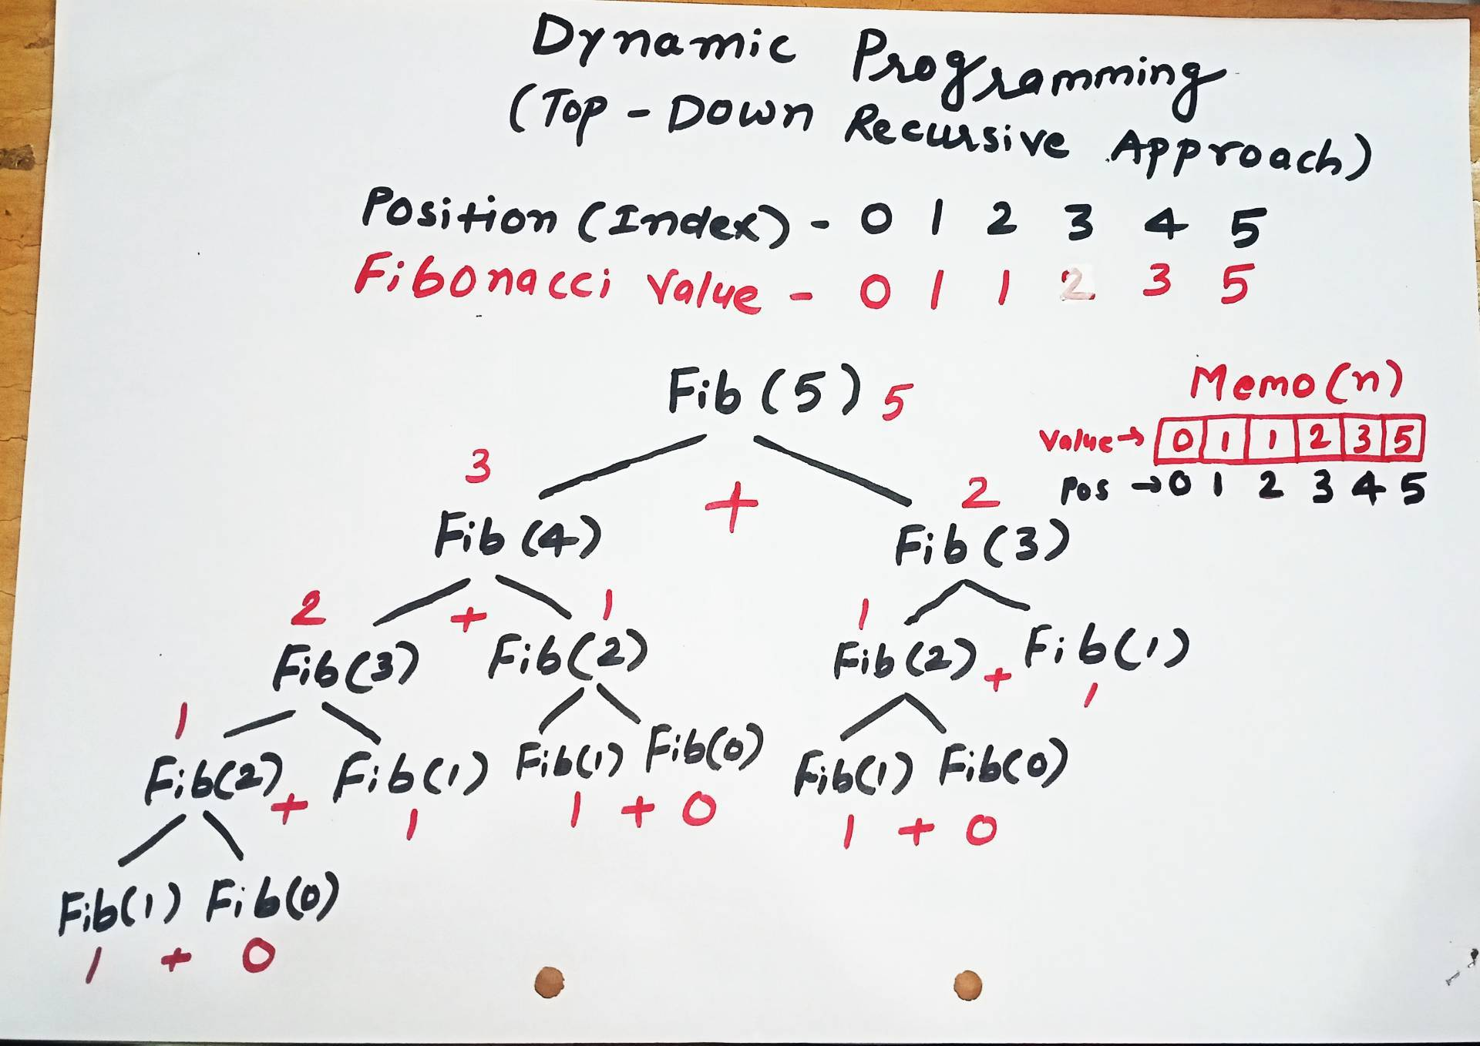
Memorization

Slide 5
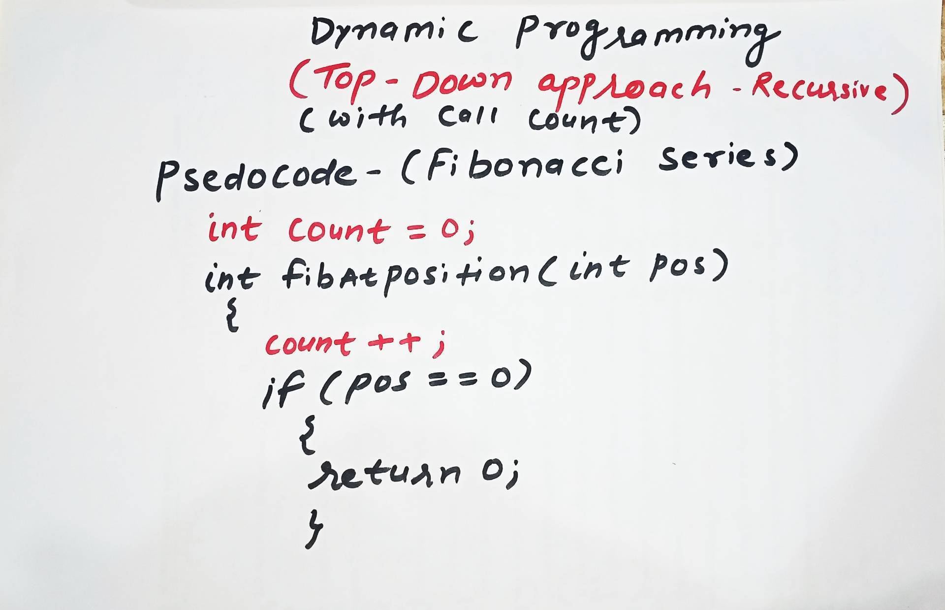
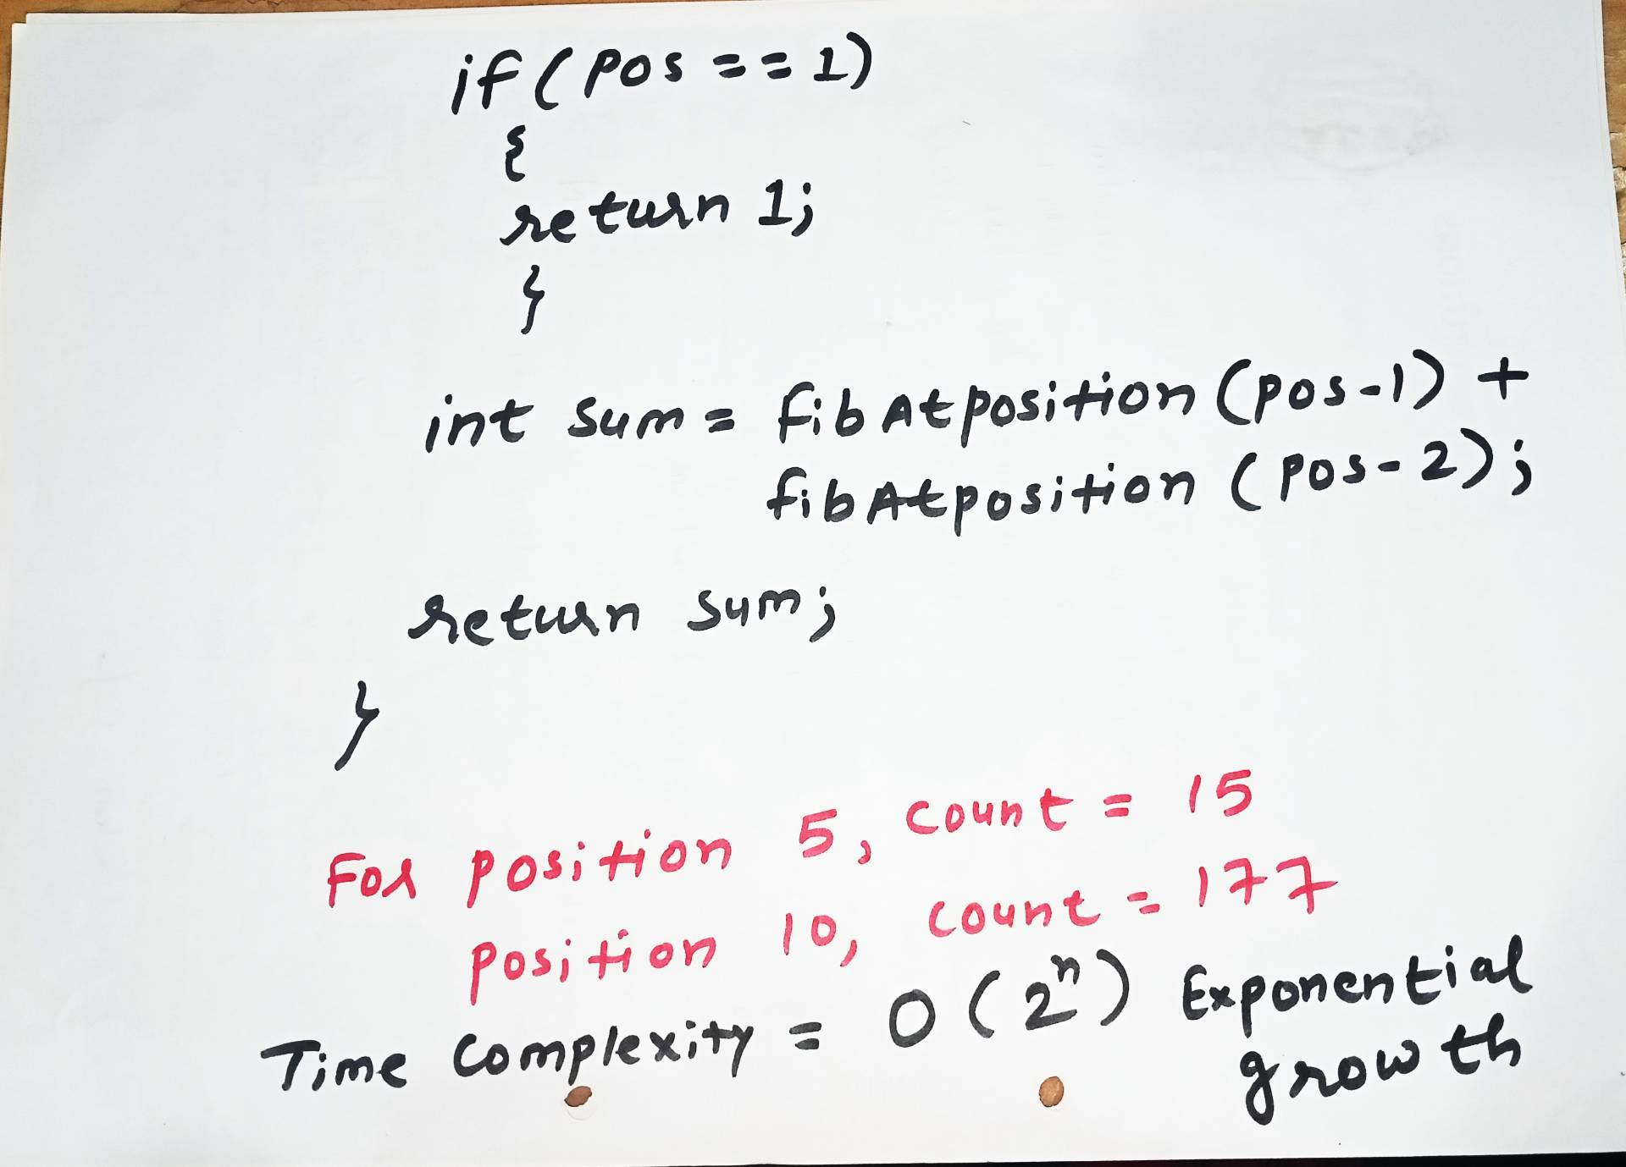
Without Memorization
C Program Link
https://github.com/dayanandyadav205/CS-402-ADA/blob/main/PPT_Notes/Unit-III/Unit-III_Programs/Fibonacci_Series/fib_top_down_recursive_with_callCount.c

Slide 6
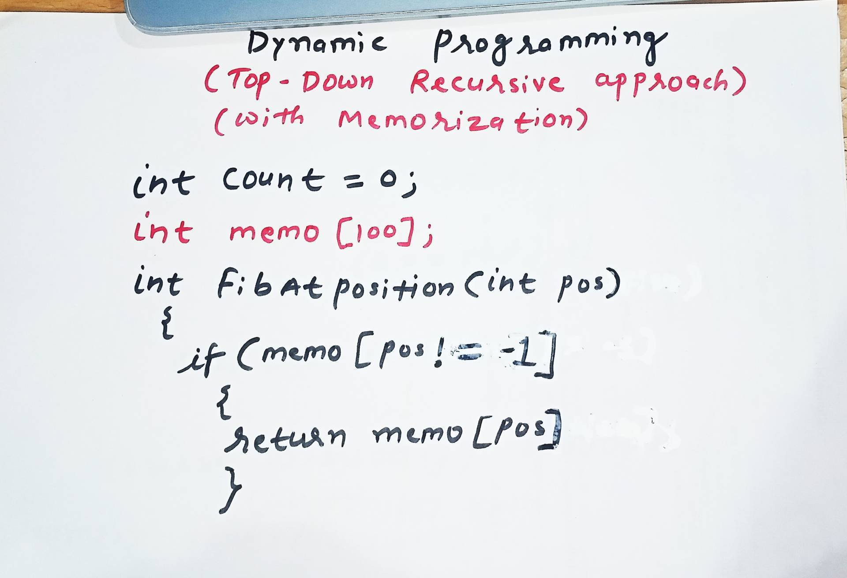
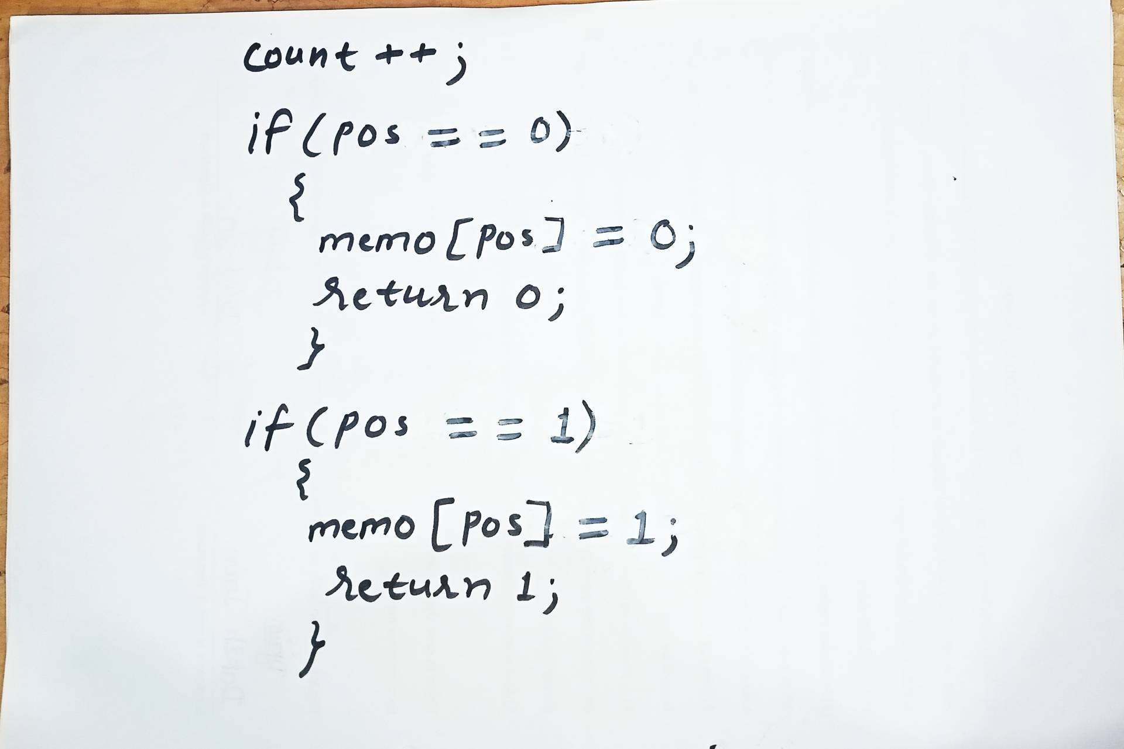
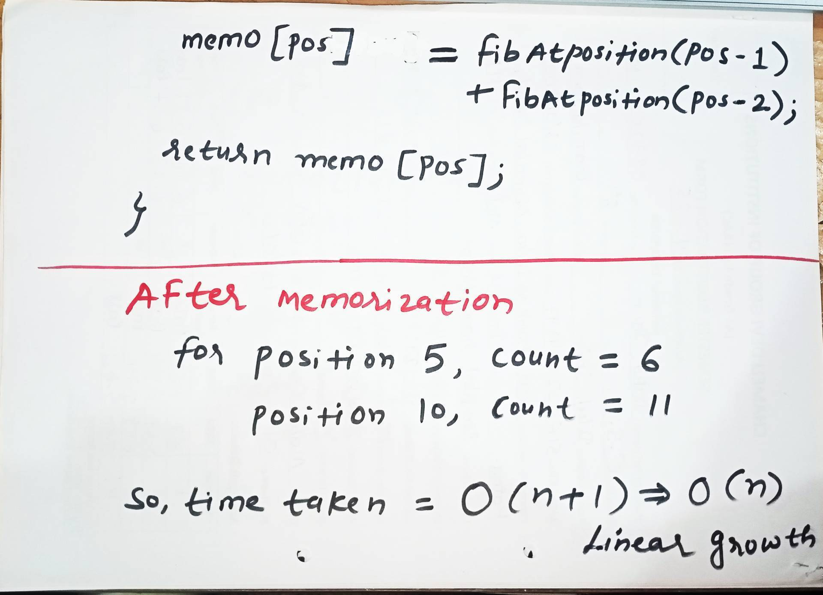
With Memorization
C Program Link
https://github.com/dayanandyadav205/CS-402-ADA/blob/main/PPT_Notes/Unit-III/Unit-III_Programs/Fibonacci_Series/fib_top_down_recursive_memorization.c

Slide 7
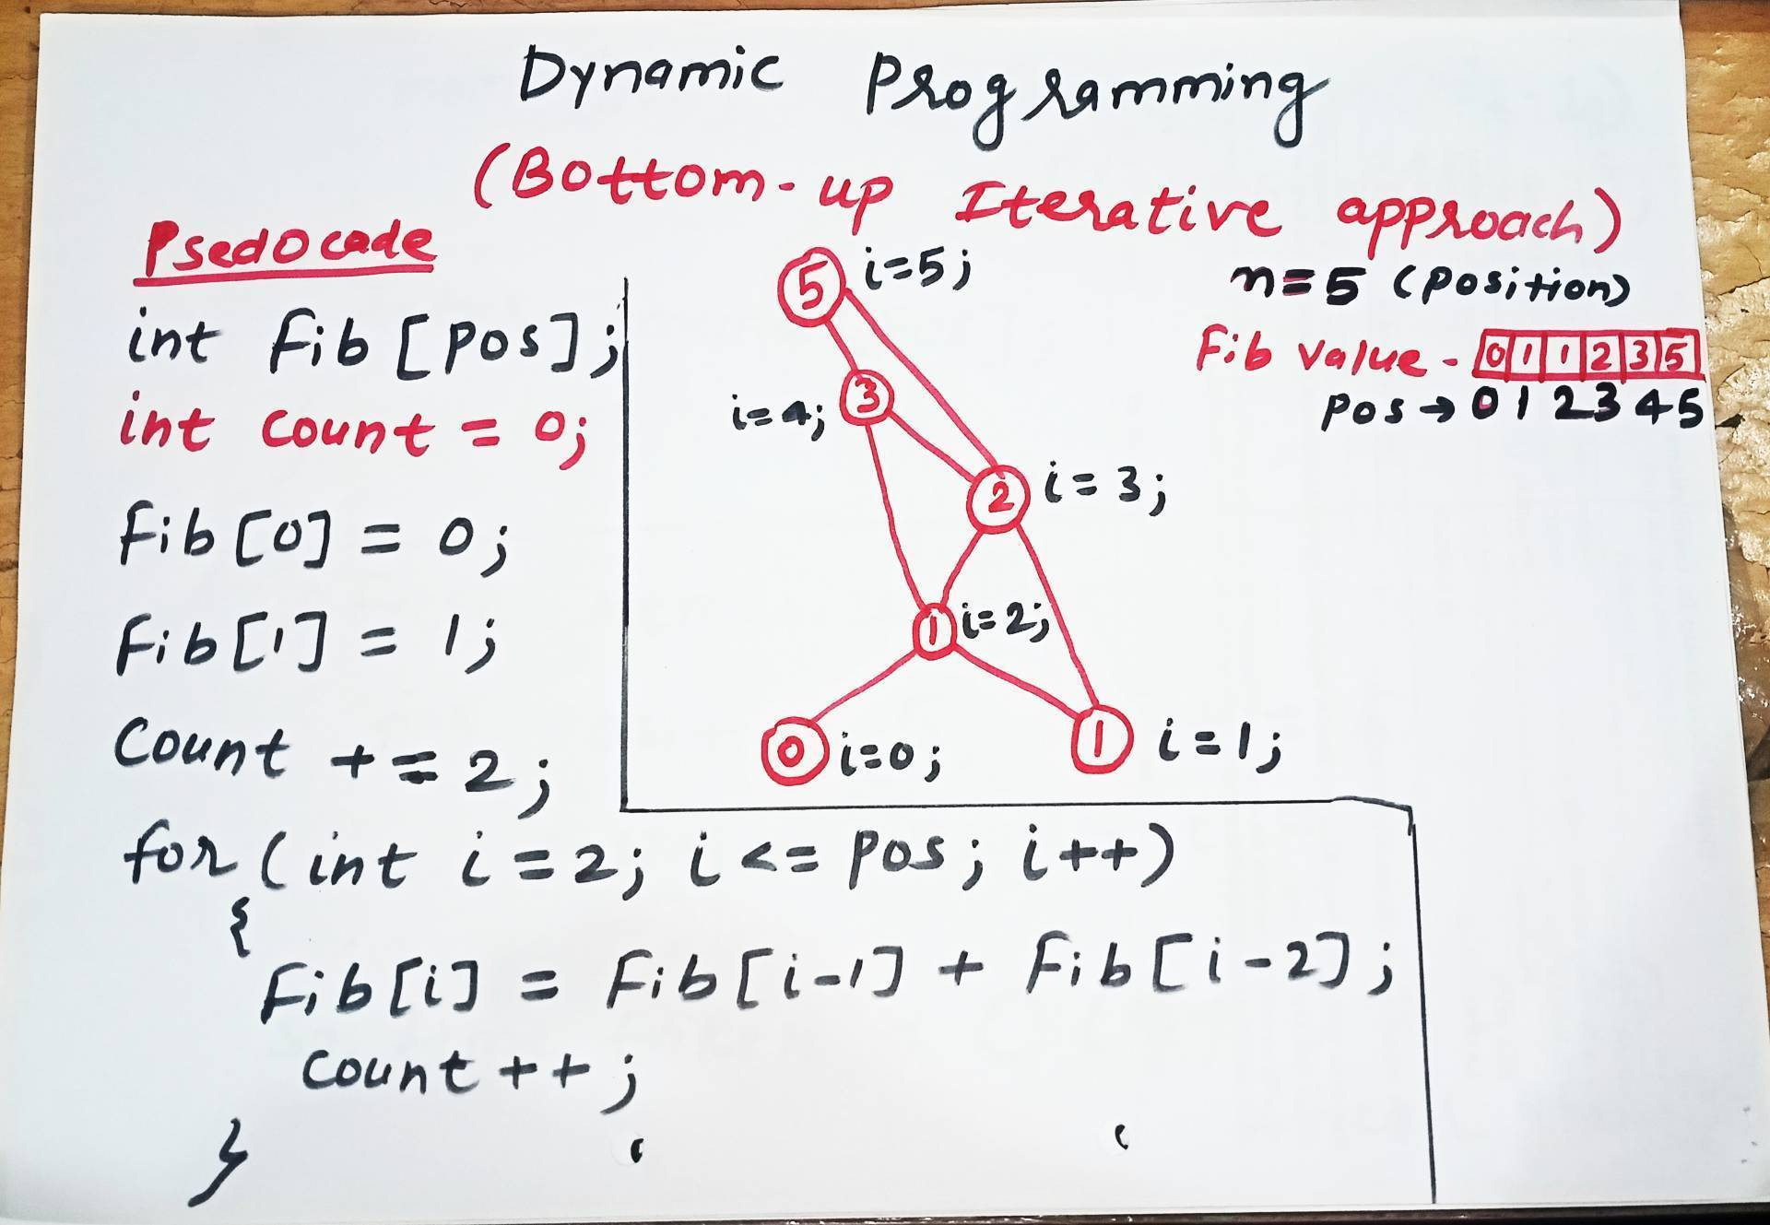
Tabulation
C Program Link
https://github.com/dayanandyadav205/CS-402-ADA/blob/main/PPT_Notes/Unit-III/Unit-III_Programs/Fibonacci_Series/fib_bottom_up_iterative_tabulation.c

Slide 8
Problems based on Dynamic Programming Approach
0/1 knapsack
Multistage graph
Reliability design
Floyd-Warshall algorithm

Slide 9
0/1 Knapsack Problem
The 0/1 Knapsack Problem is a classic optimization problem in computer science where you must select a subset of indivisible items to maximize total value without exceeding a maximum weight capacity. The name "0/1" comes from the rule that you cannot take a fraction of an item; you must either leave it (0) or take it entirely (1).

Slide 10
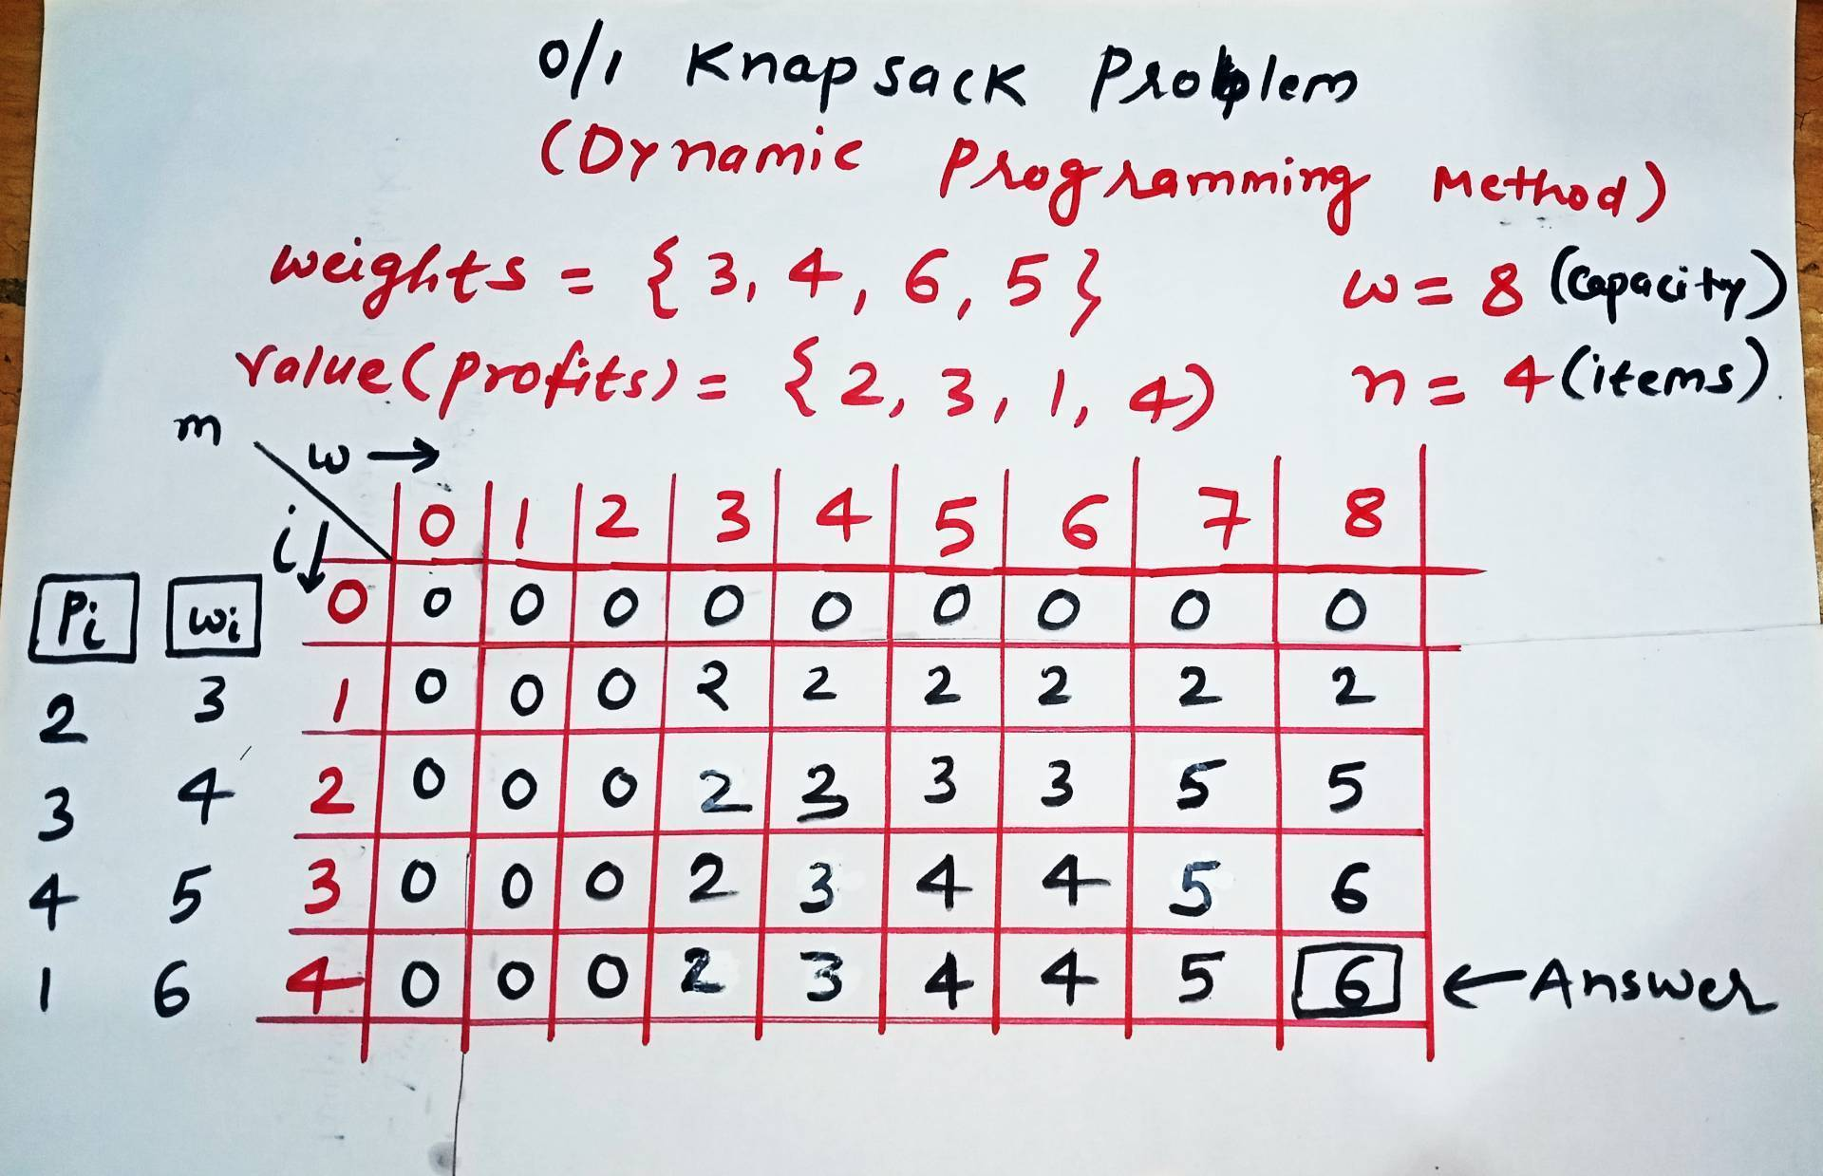
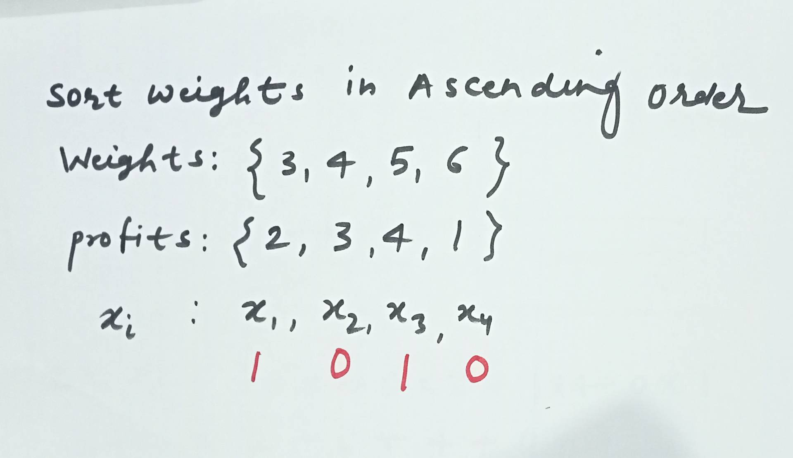
0/1 Knapsack problem

Slide 11
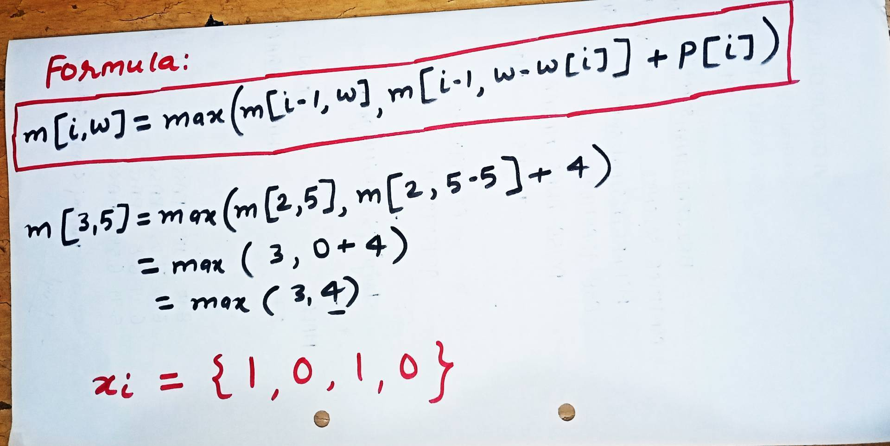
0/1 Knapsack problem

Slide 12
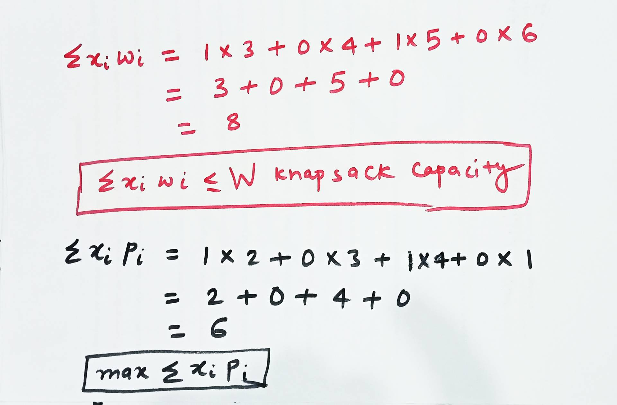
0/1 Knapsack problem
The time complexity of the 0/1 Knapsack problem using dynamic programming is O(N.W)
Here, N represents the total number of items, and W represents the maximum weight capacity of the knapsack.

Slide 13
0/1 Knapsack problem
Example 2
Capacity (W) = 7,
No. of items (n) = 5
Weights | 3 | 2 | 4 | 5 | 1
Profits | 50 | 40 | 70 | 80 | 10
Formula to get max profit for each weight: m[i,w] = max(m[i-1, w], m[i-1, w-w[i]] + p[i])
w
i
0 | 1 | 2 | 3 | 4 | 5 | 6 | 7
0 | 0 | 0 | 0 | 0 | 0 | 0 | 0
0 | 0 | 0 | 50 | 50 | 50 | 50 | 50
0 | 0 | 40 | 50 | 50 | 90 | 90 | 90
0 | 0 | 40 | 50 | 70 | 90 | 110 | 120
0 | 0 | 40 | 50 | 70 | 90 | 110 | 120
0 | 10 | 40 | 50 | 70 | 90 | 110 | 120
xi | pi | wi
x1 | 50 | 3
x2 | 40 | 2
x3 | 70 | 4
x4 | 80 | 5
x5 | 10 | 1
0
1
2
3
4
5
xi | x1 | x2 | x3 | x4 | x5
Selected objects | 1 | 0 | 1 | 0 | 0
Max(∑xipi) = 1x50 + 0x40 + 1x70 + 0x80 + 0x10 = 120 (Max Profit)
(∑xiwi<=W) = 1x3 + 0x2 + 1x4 + 0x5 + 0x1 = 7 (Max capacity)

Slide 14
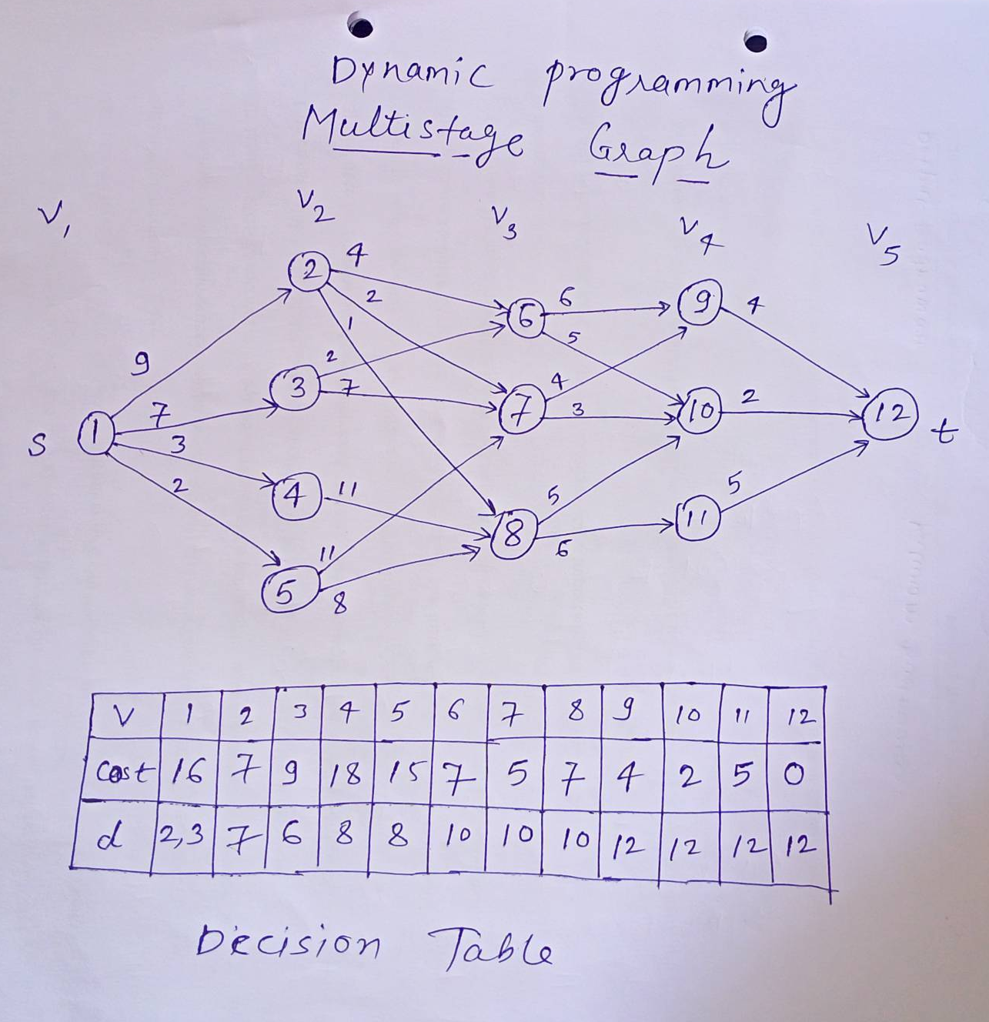
Multistage graph
A Multistage graph is a directed, weighted graph in which the nodes can be divided into a set of stages such that all edges are from a stage to next stage only (In other words there is no edge between vertices of same stage and from a vertex of current stage to previous stage).

Slide 15
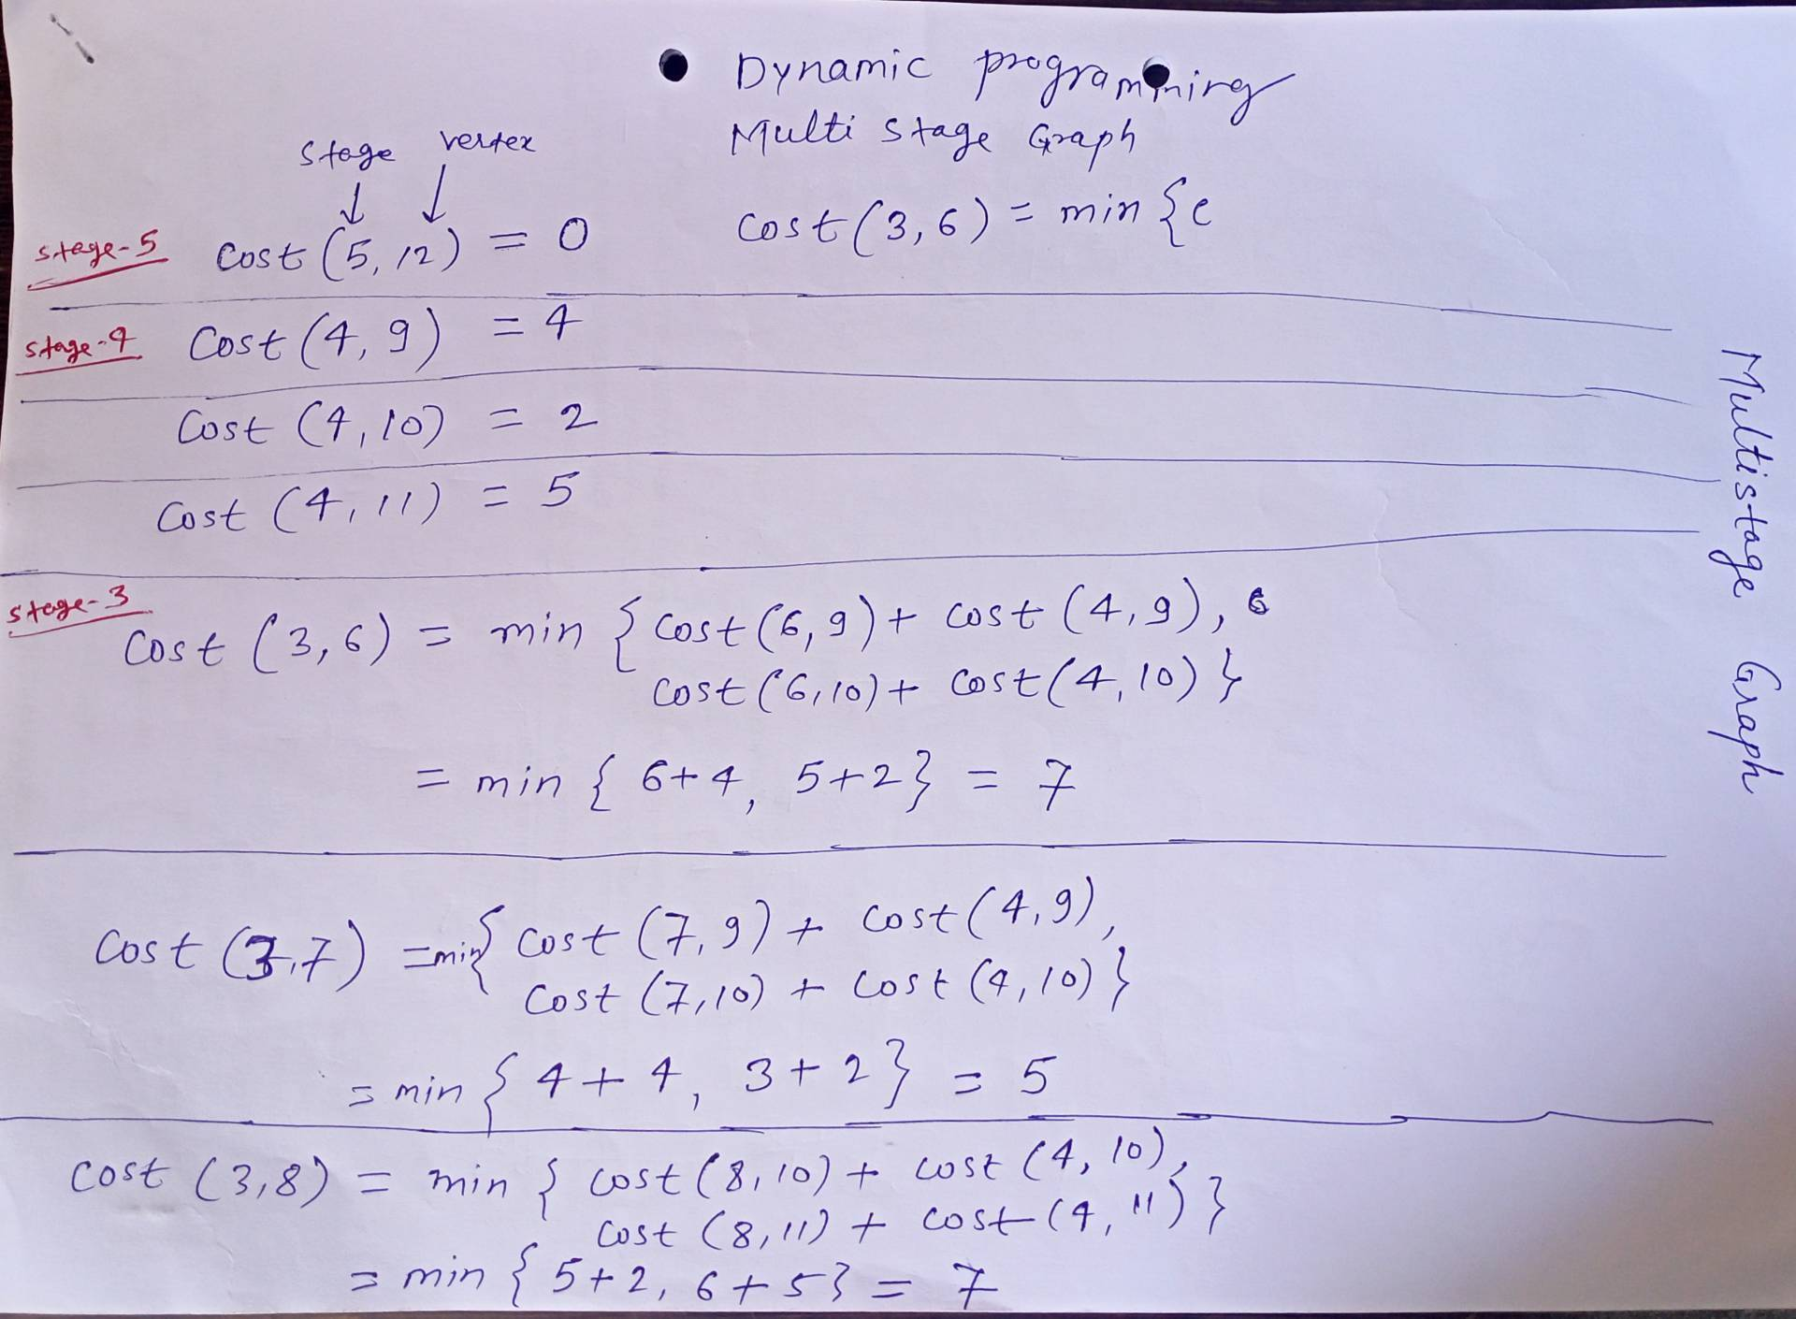




Multistage graph

Slide 16
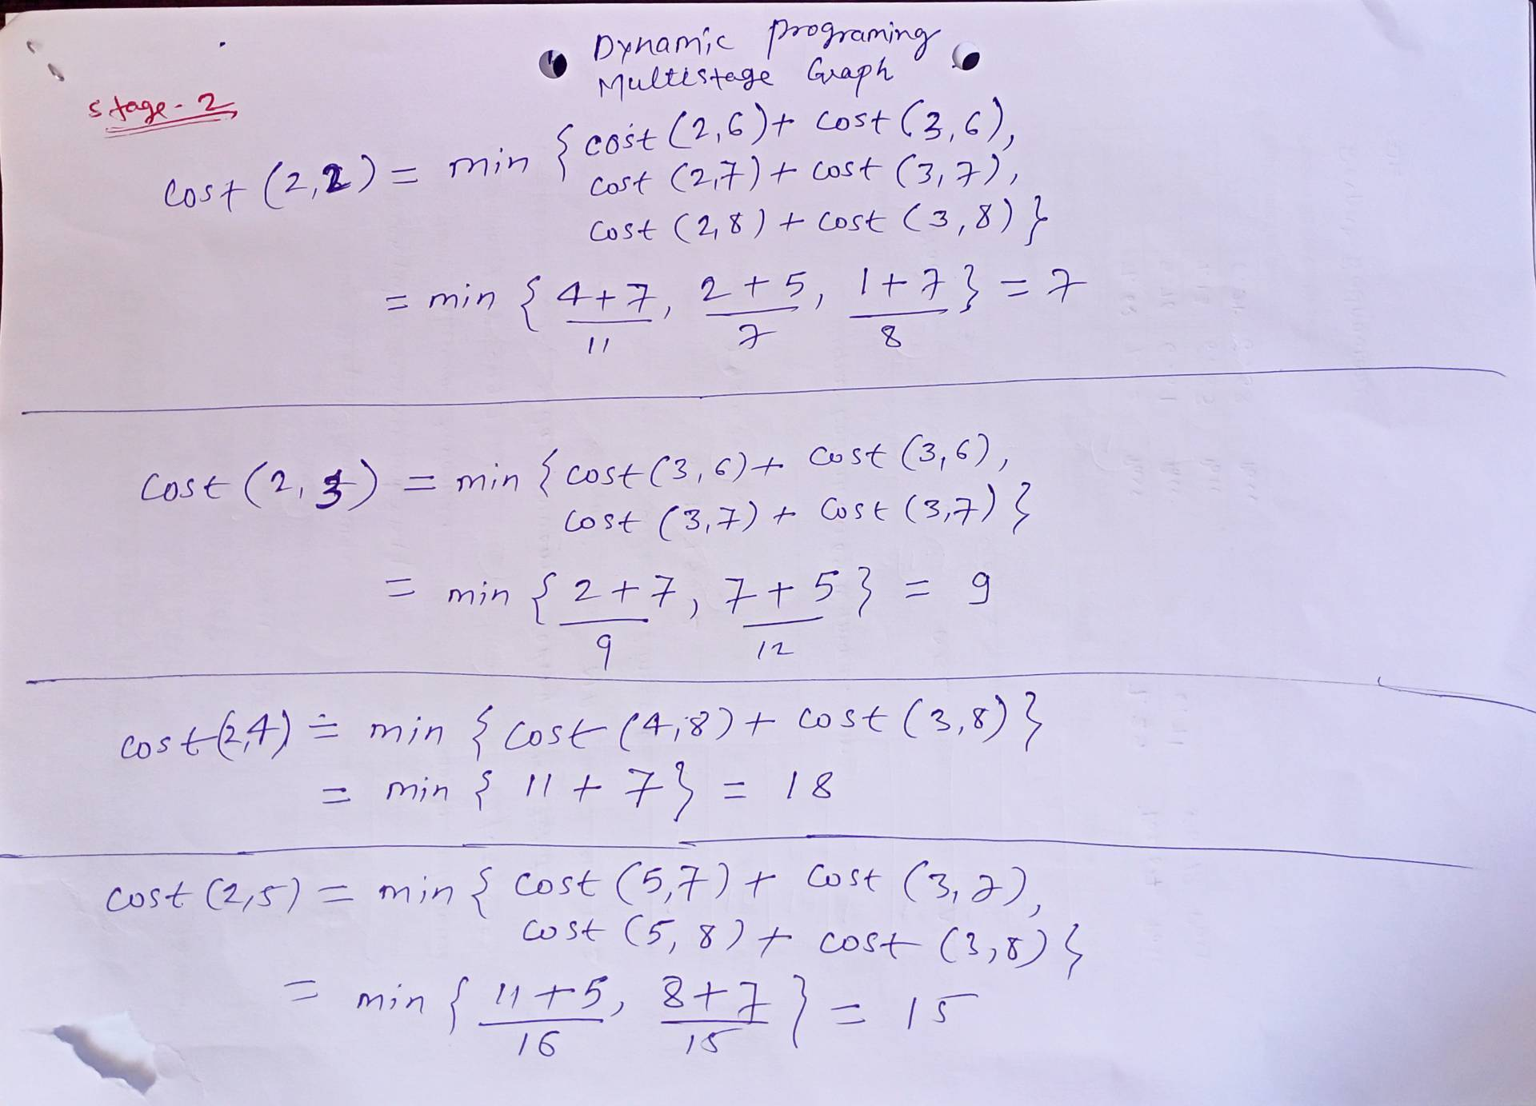
Multistage graph

Slide 17
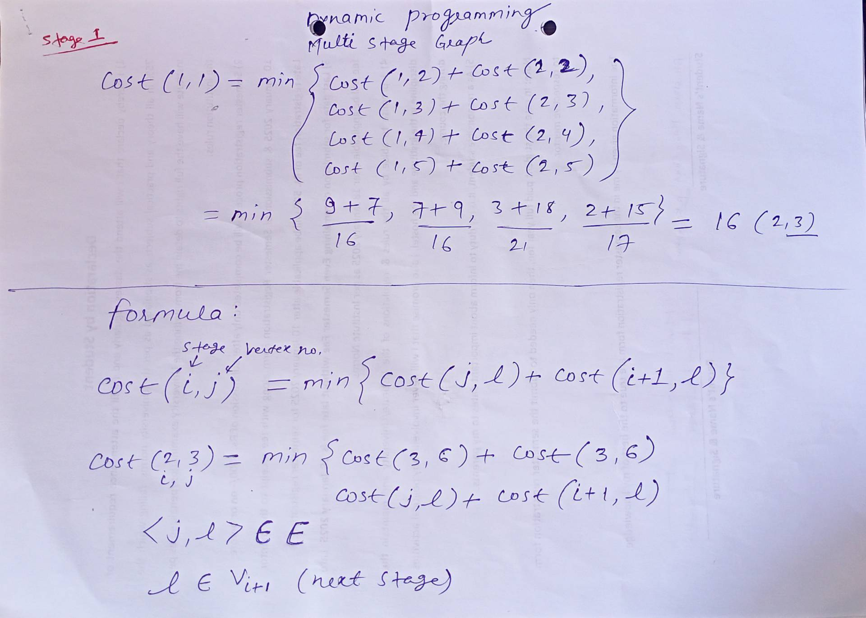
Multistage graph

Slide 18
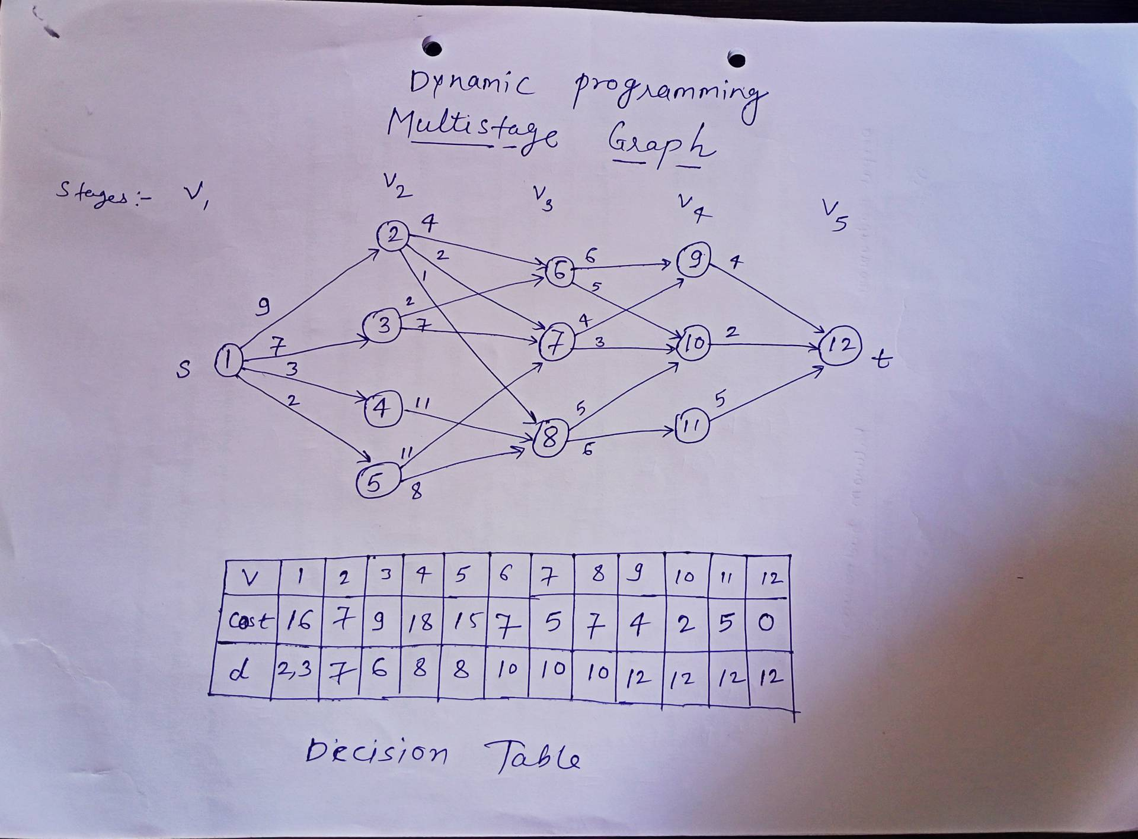
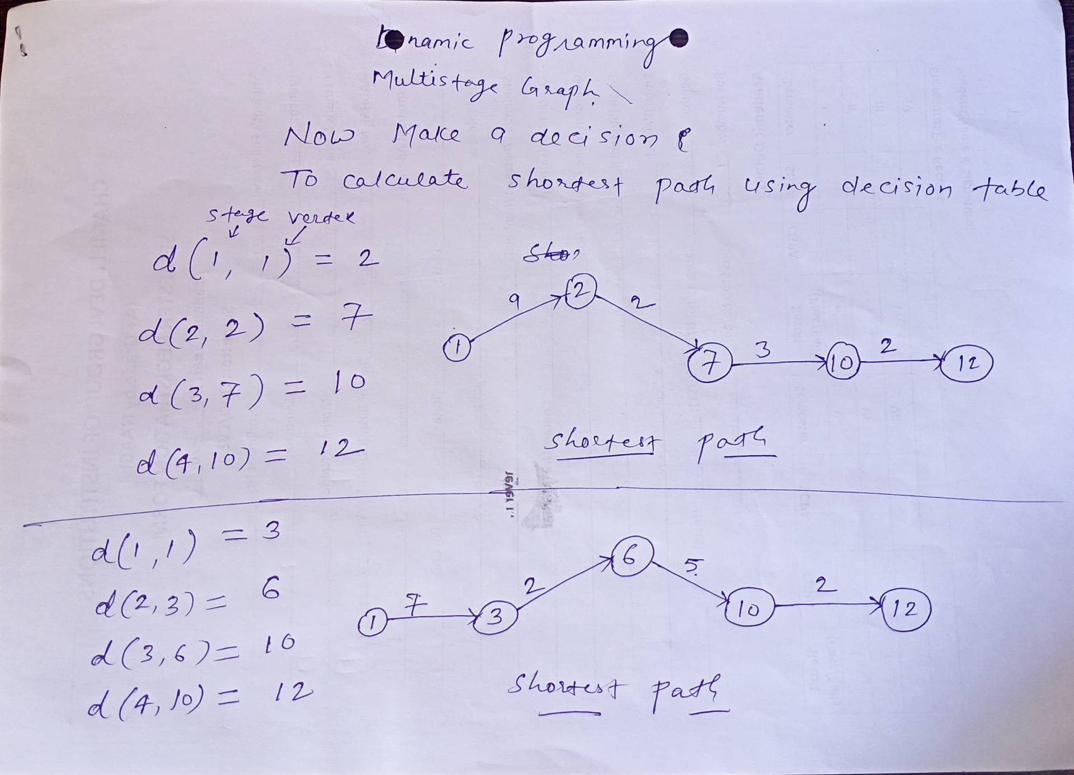
Multistage graph
The total time complexity of solving the multistage graph shortest path problem using dynamic programming is O(|V| + |E|)
Where,
|V| = no. of vertex
|E| = no. of edges

Slide 19
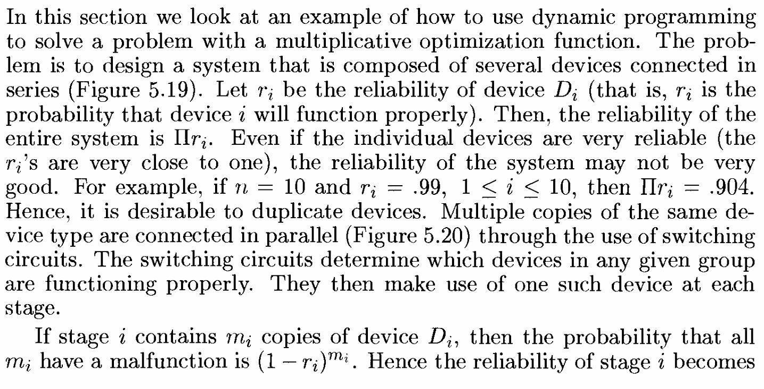
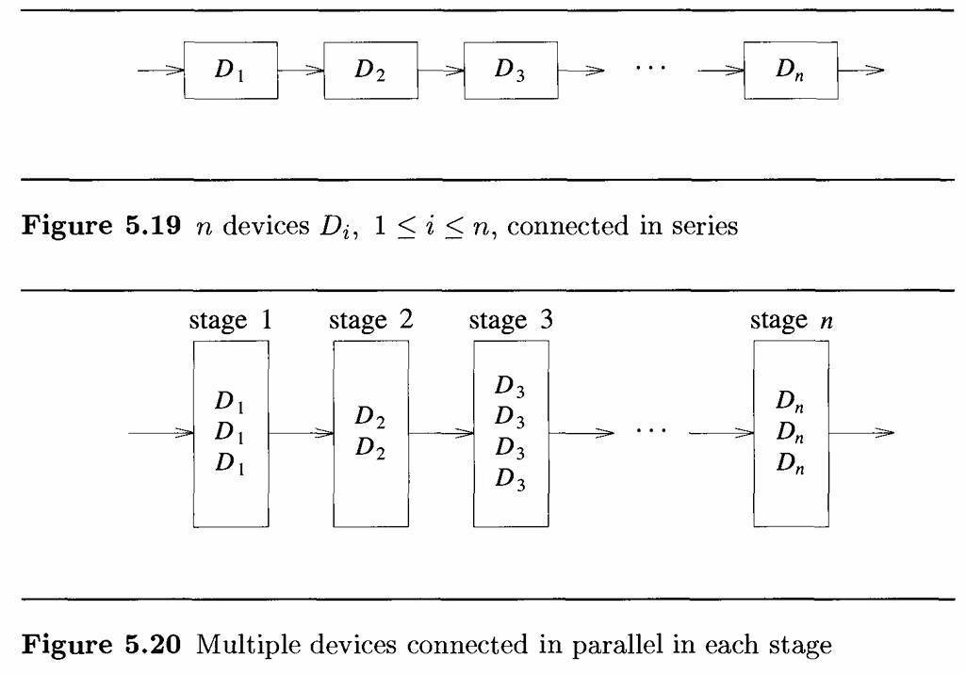
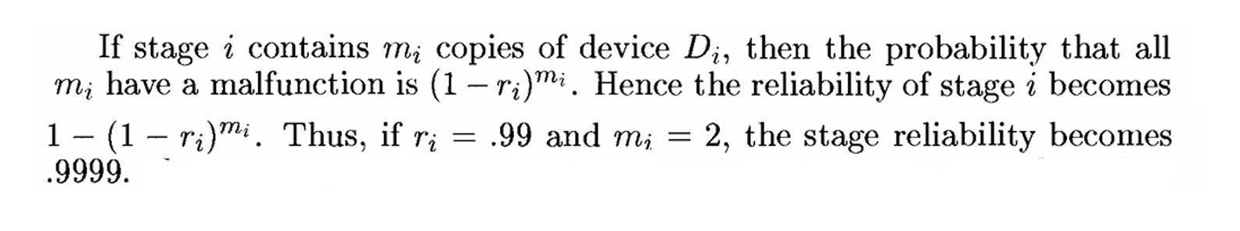
Reliability Design

Slide 20
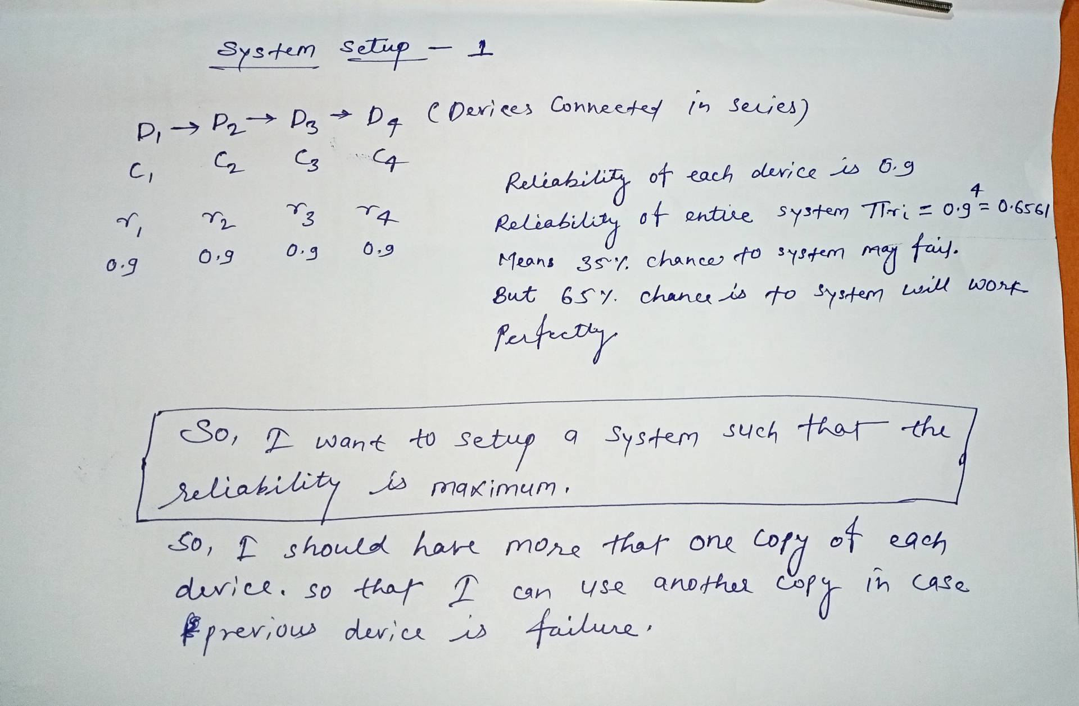
Reliability Design

Slide 21
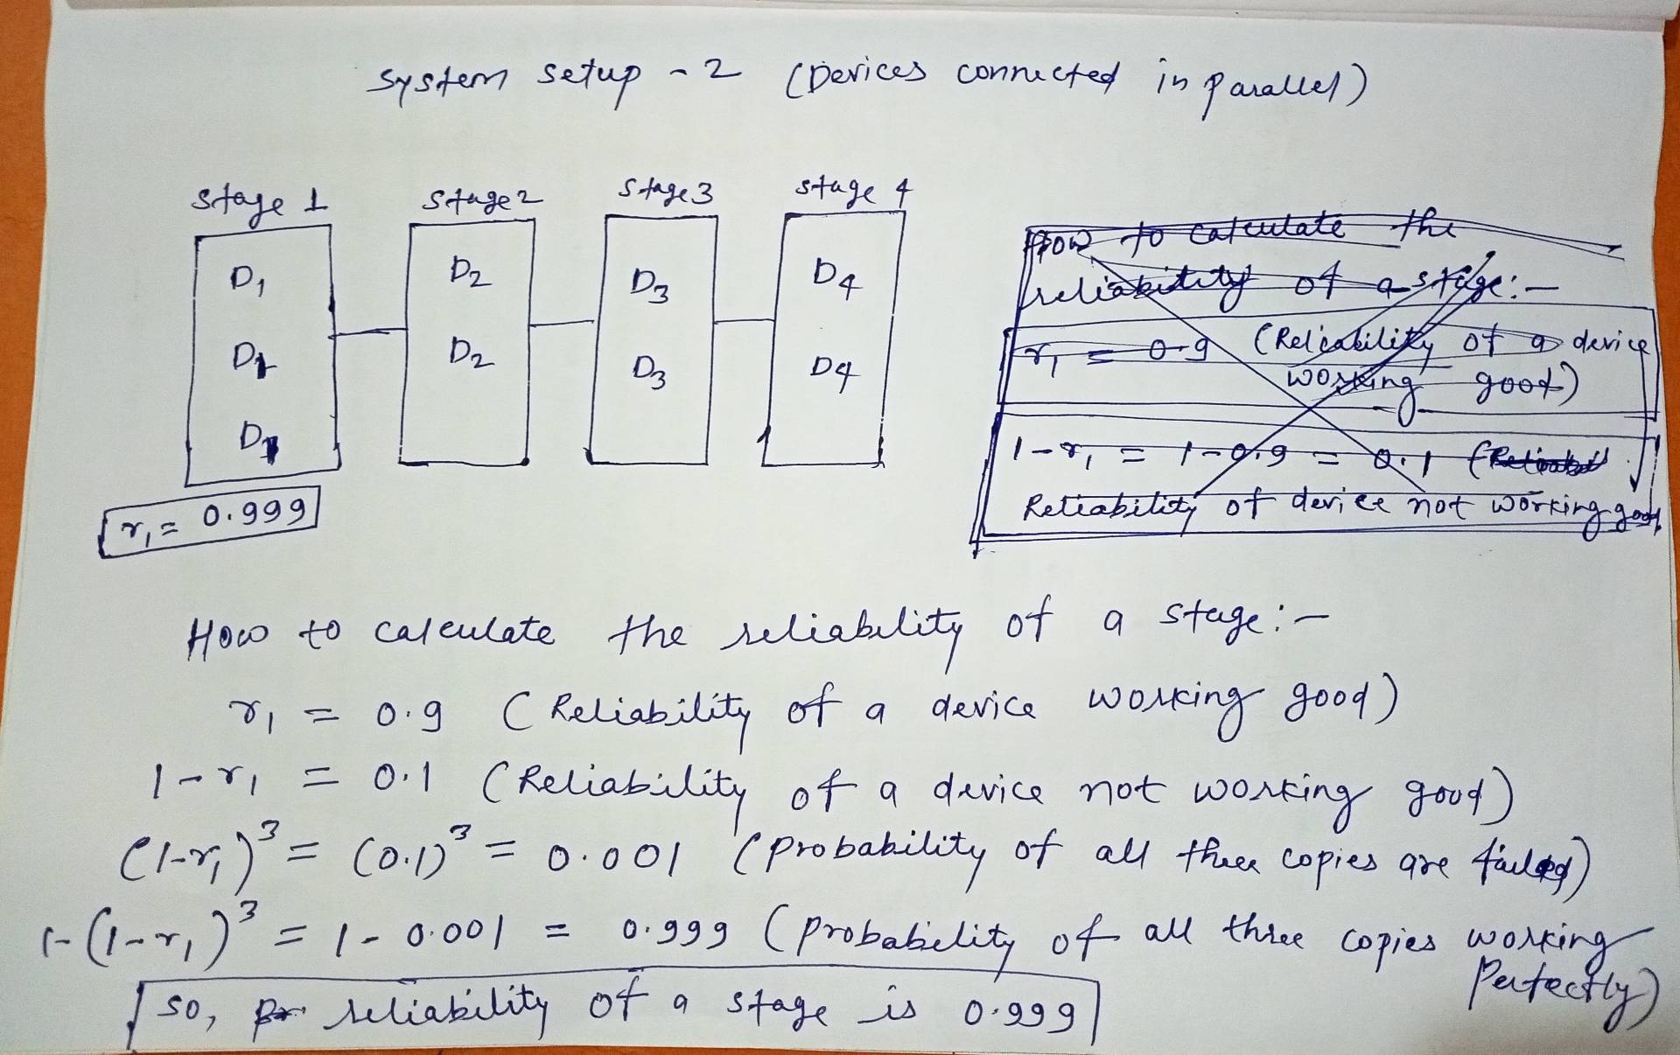
Reliability Design

Slide 22
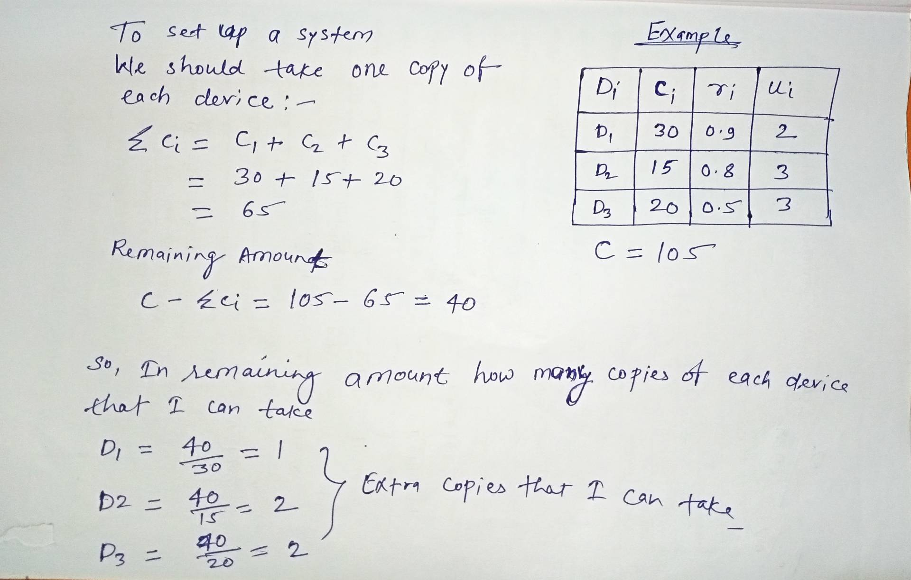
Reliability Design

Slide 23
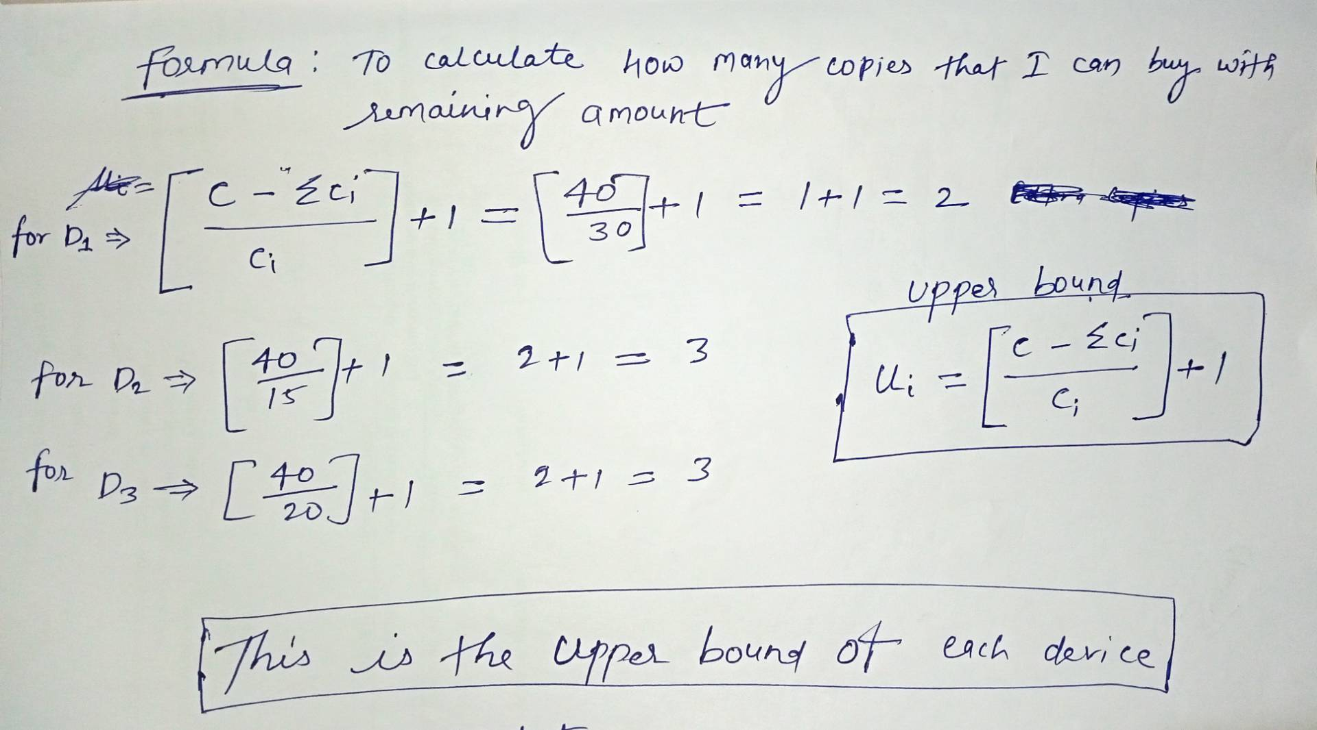
Reliability Design

Slide 24
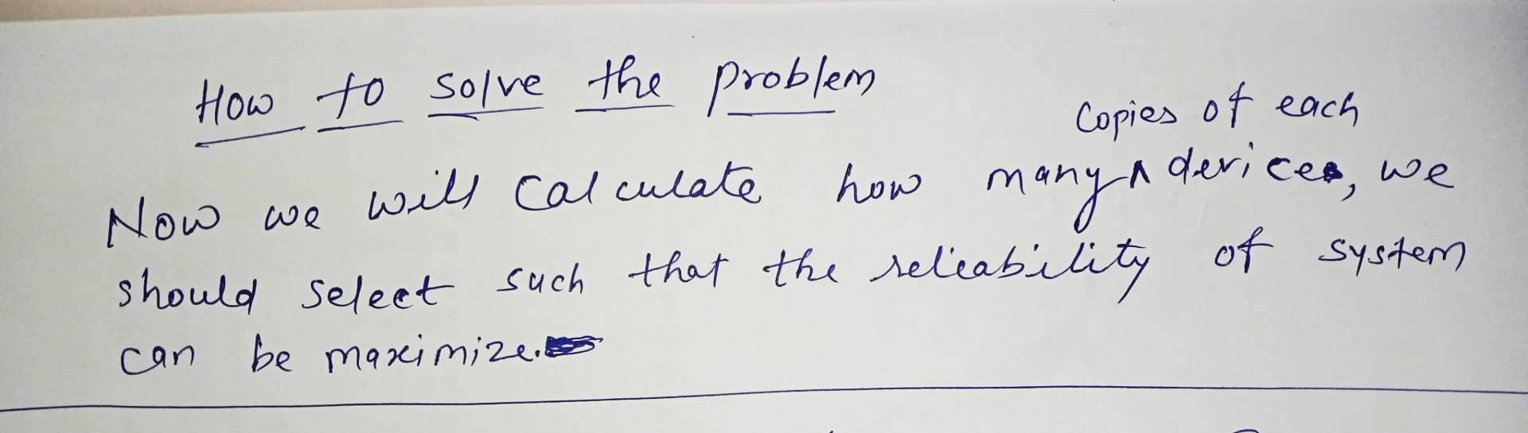
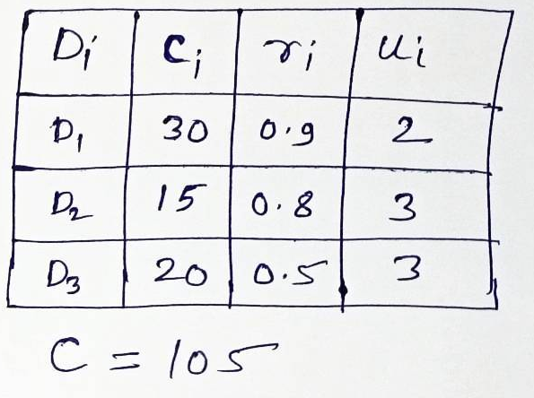
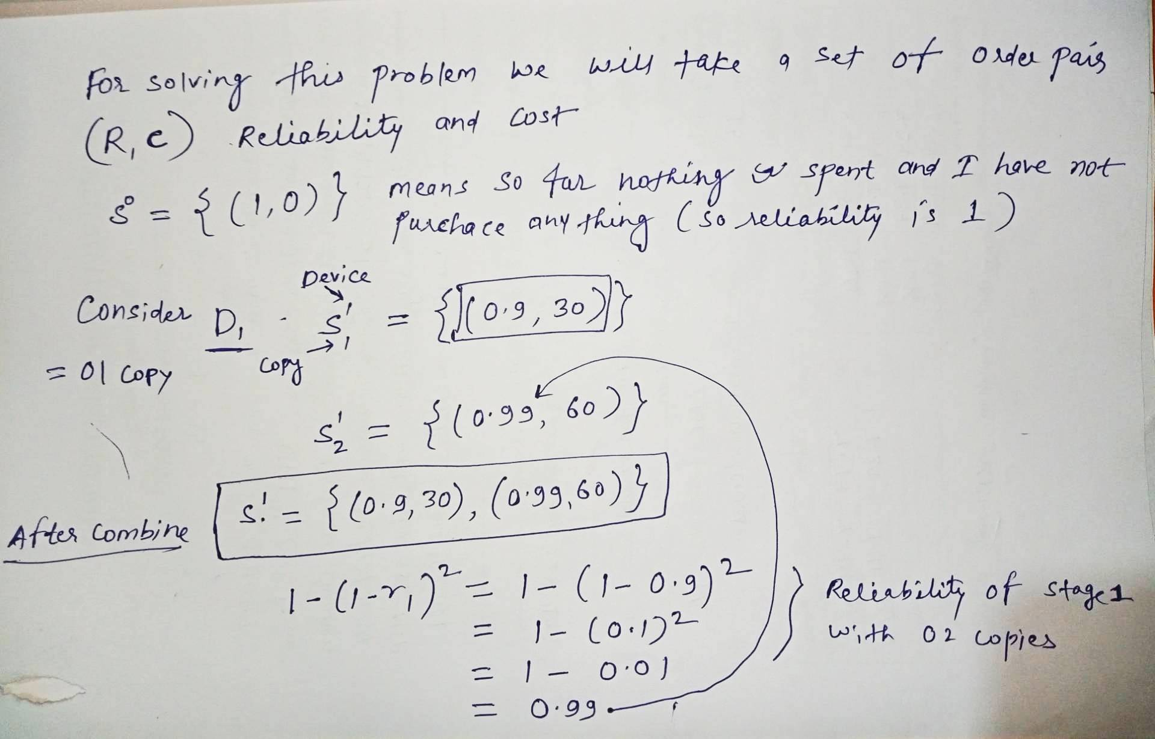
Reliability Design

Slide 25

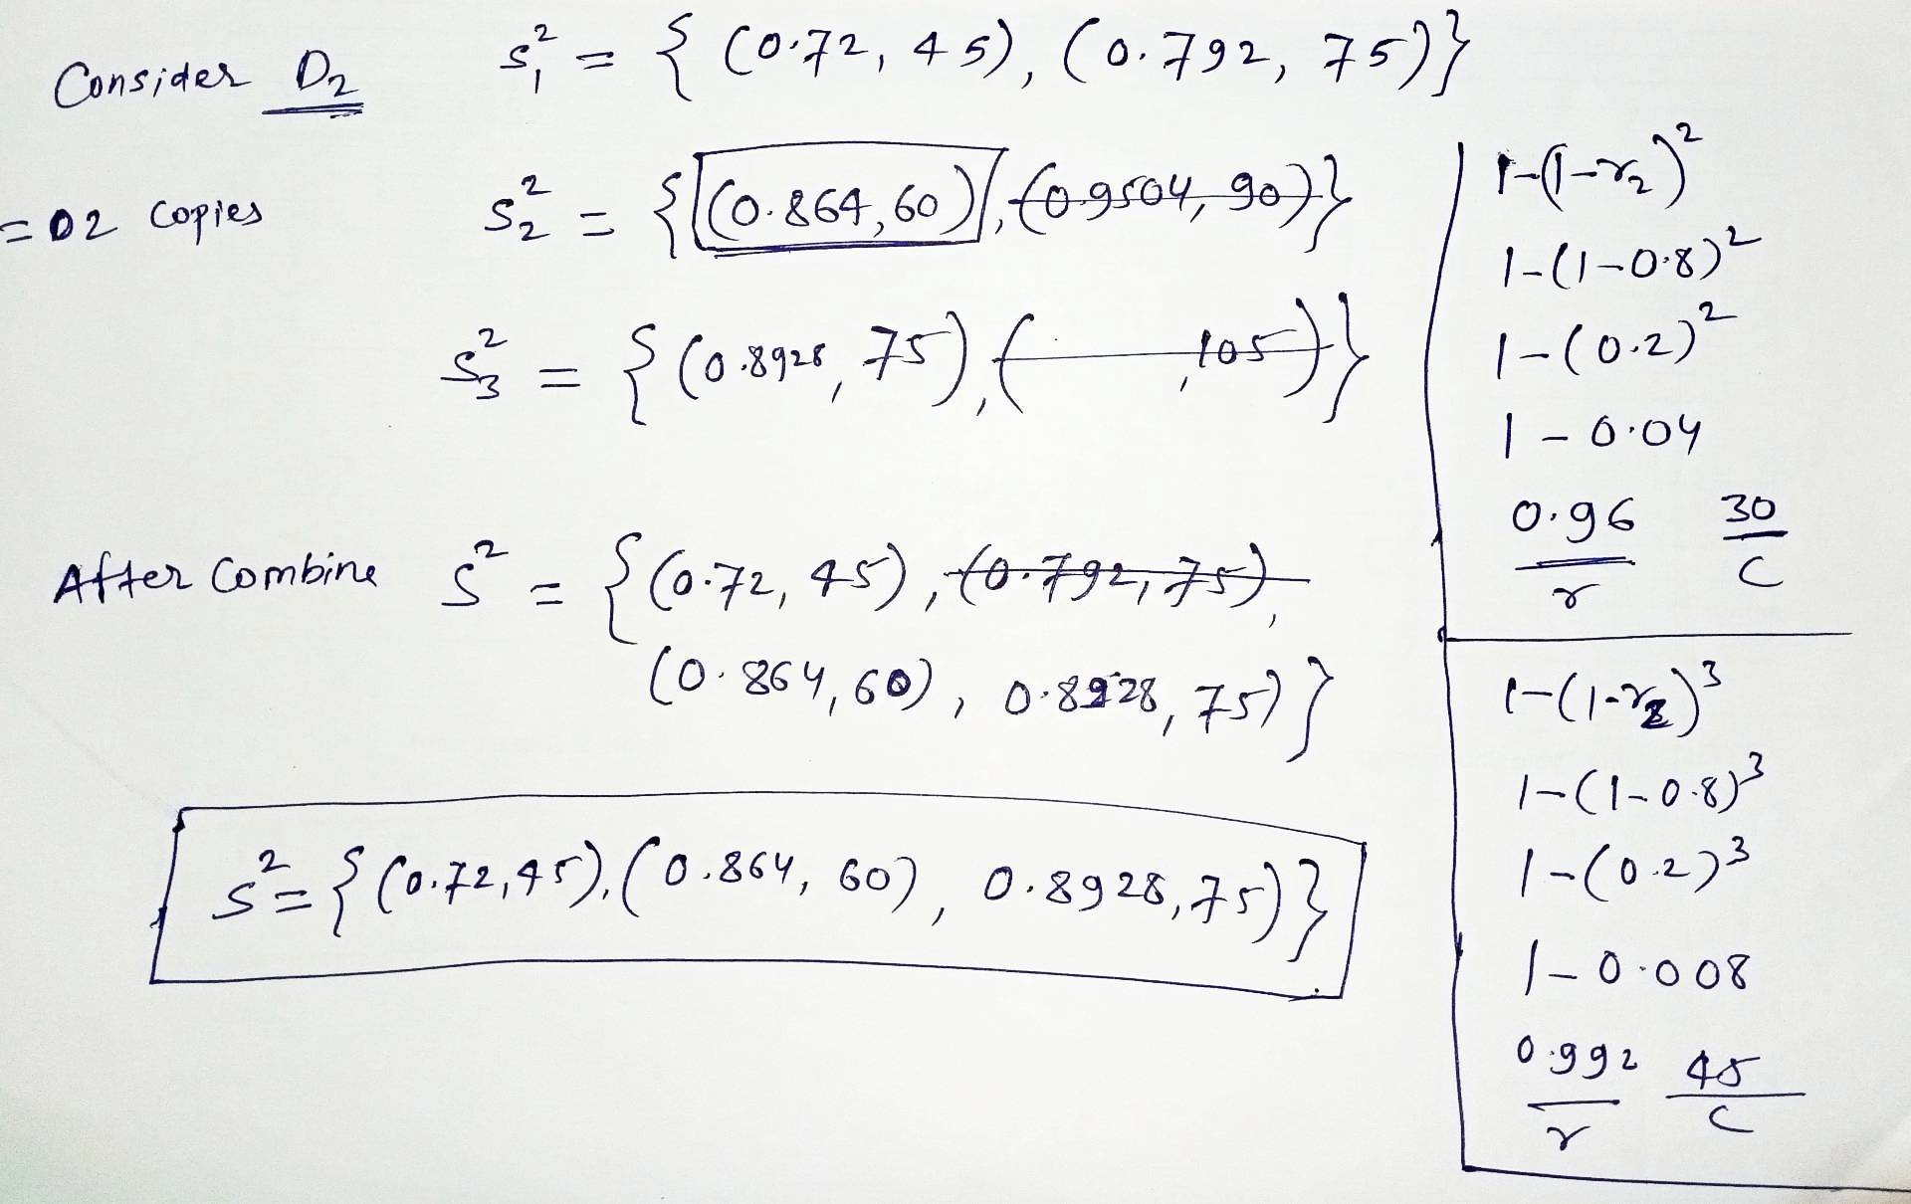
Reliability Design

Slide 26
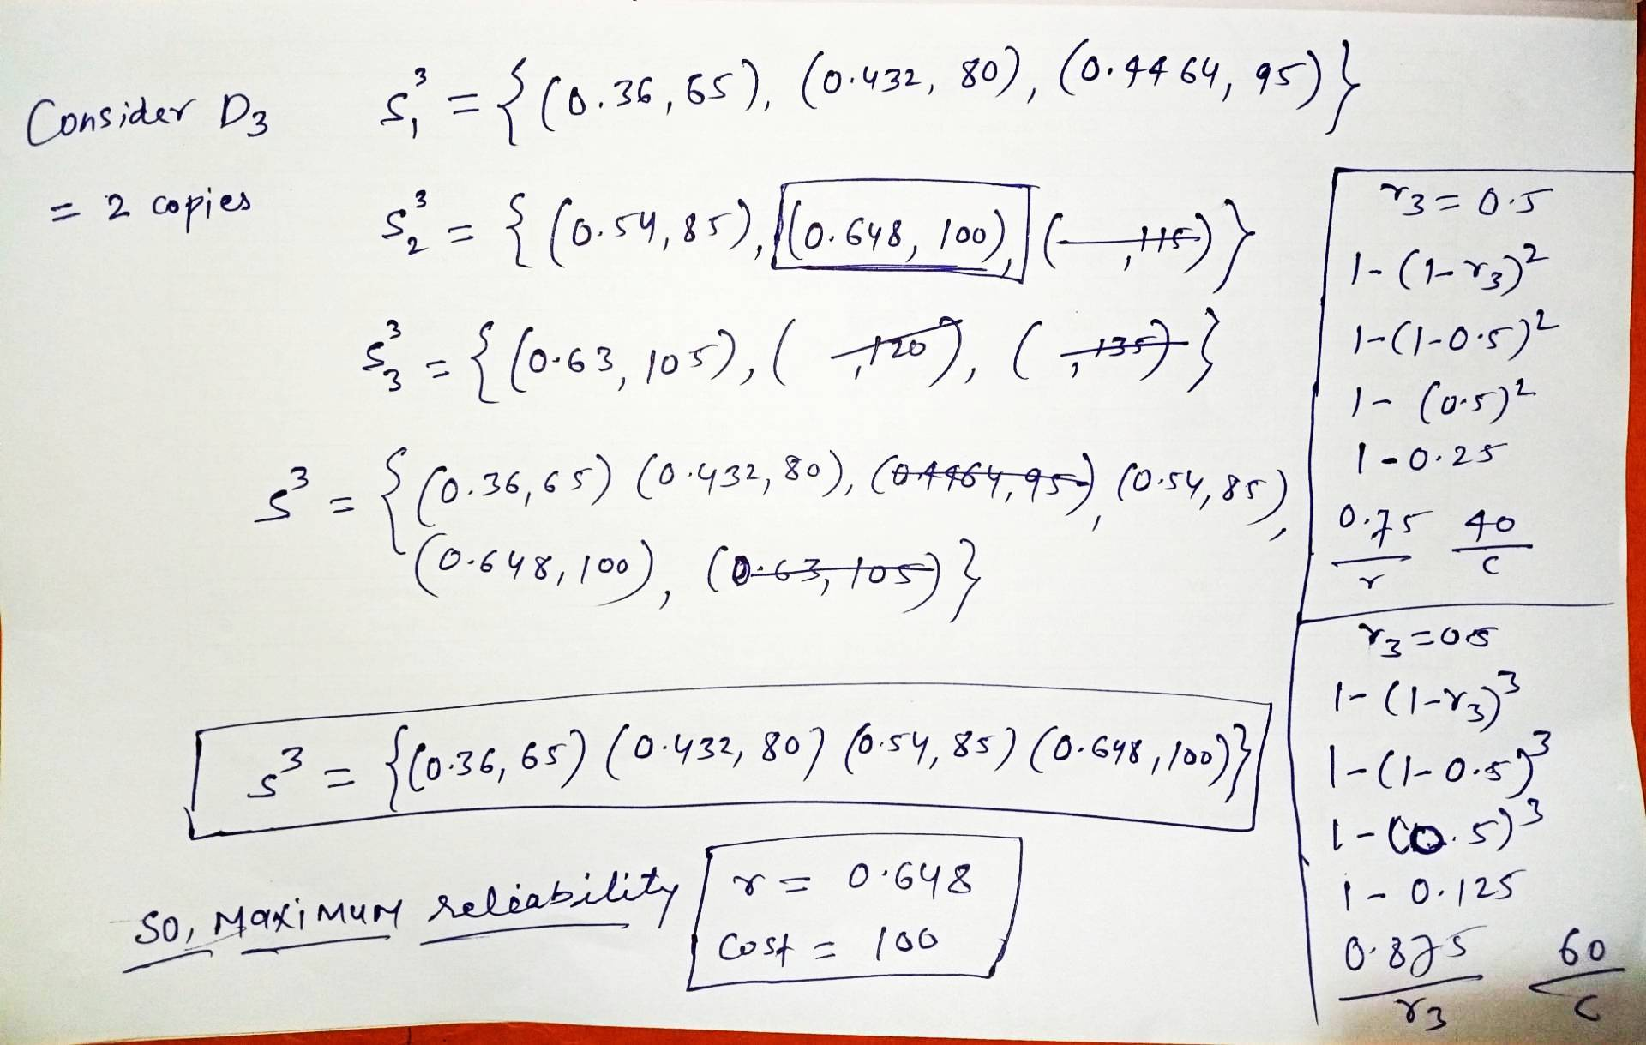

Reliability Design

Slide 27
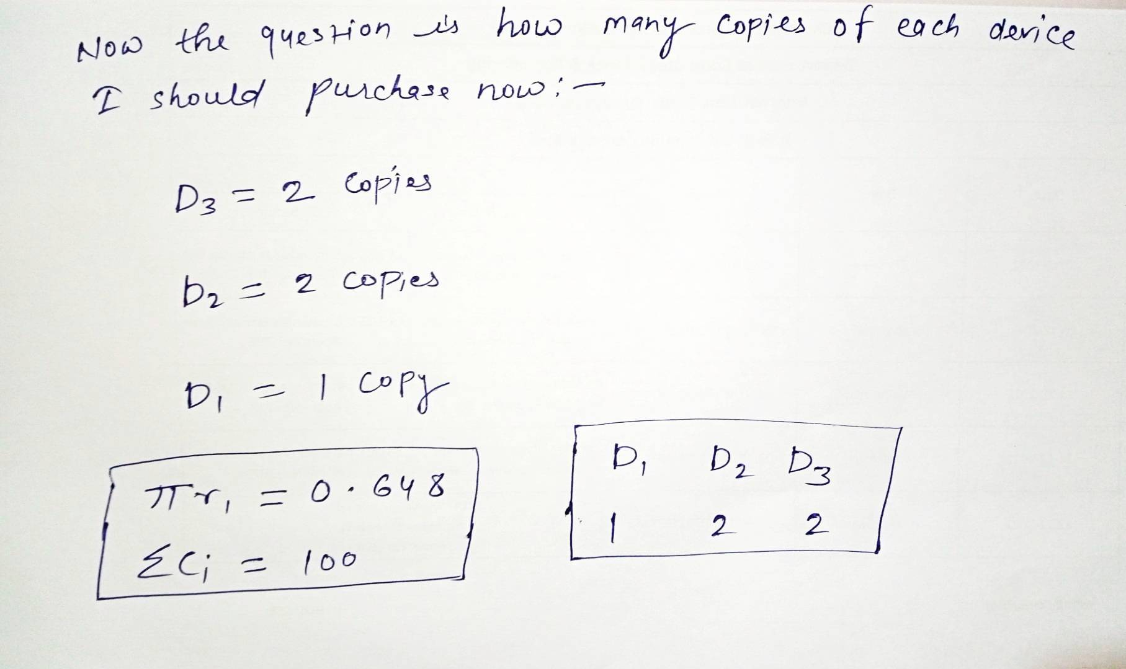







Reliability Design
Di | ci | ri | ui | Selected ui
D1 | 30 | 0.9 | 2 | 1
D2 | 15 | 0.8 | 3 | 2
D3 | 20 | 0.5 | 3 | 2
The time complexity of the reliability design problem using dynamic programming is O(s.c.u)
where s is the number of stages (or unique devices), c is the total cost constraint (budget), and u is the maximum number of extra copies allowed for any single stage.

Slide 28
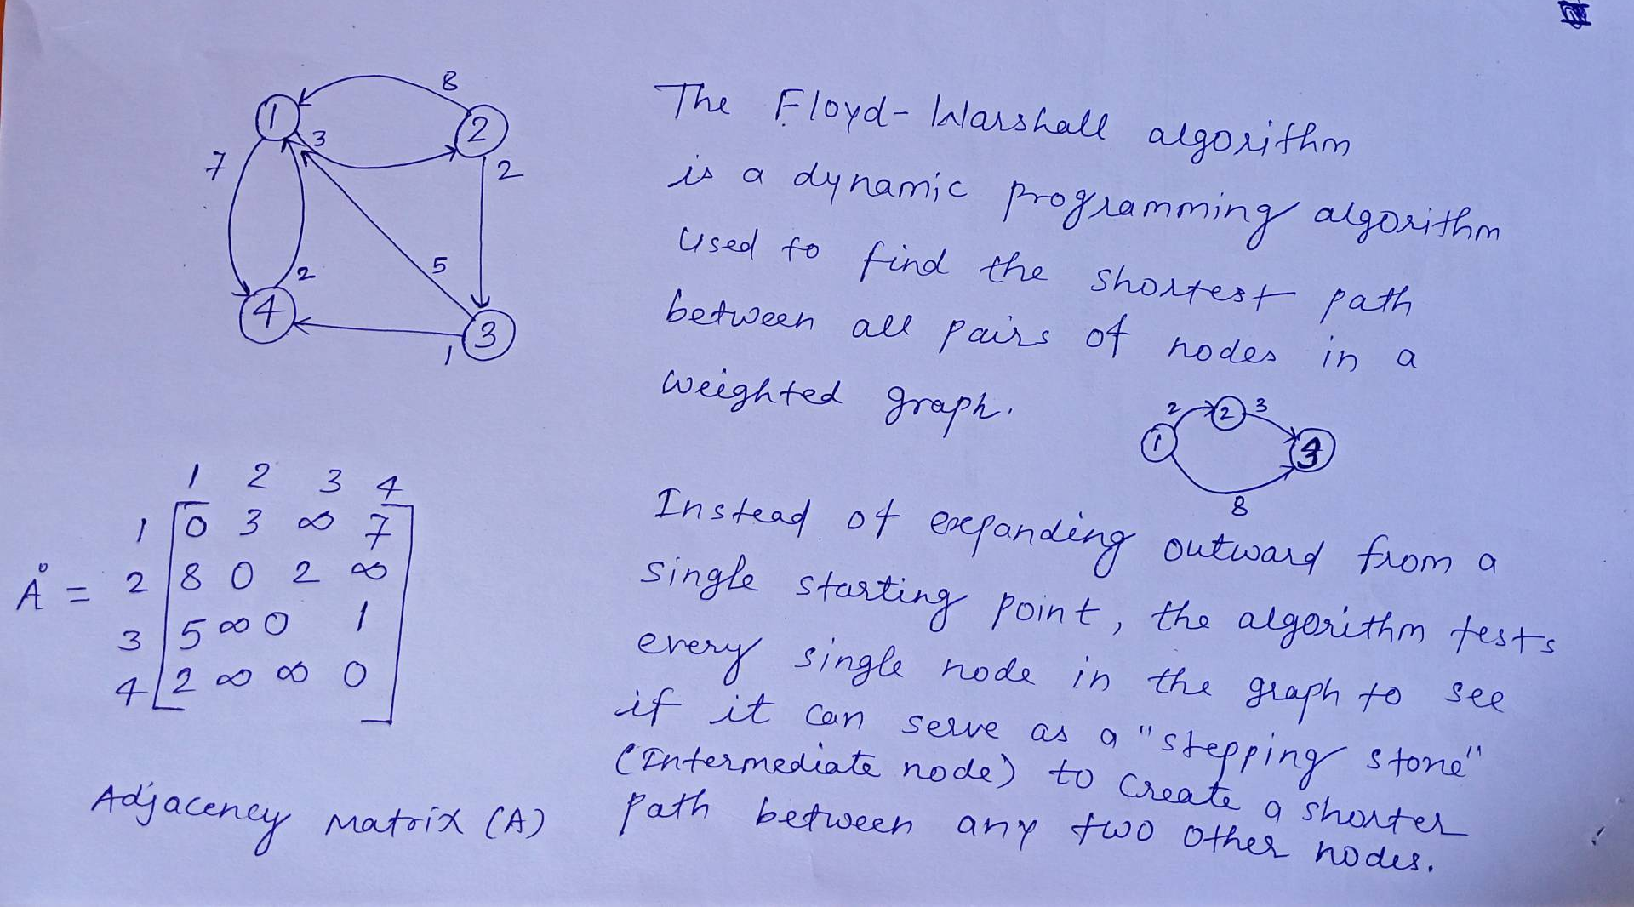
All Pairs Shortest Path (Floyd-Warshall algorithm)

Slide 29
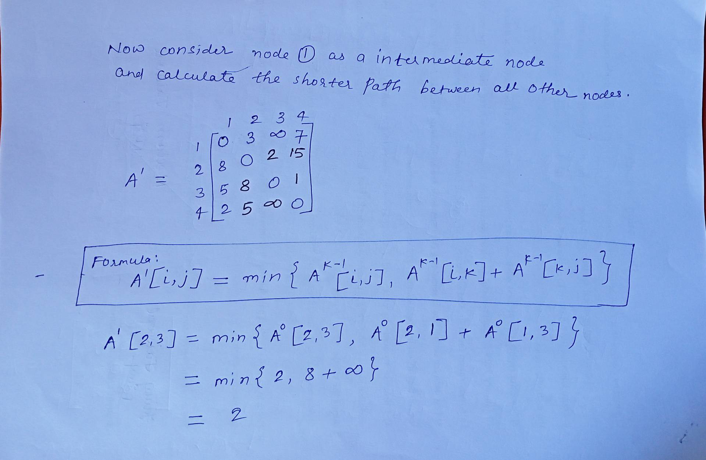
All Pairs Shortest Path (Floyd-Warshall algorithm)

Slide 30
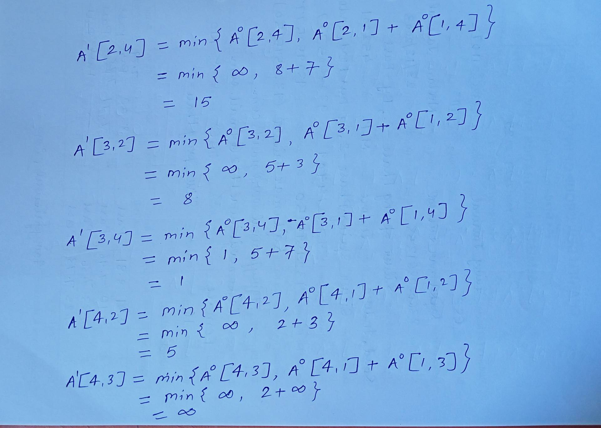
All Pairs Shortest Path (Floyd-Warshall algorithm)

Slide 31
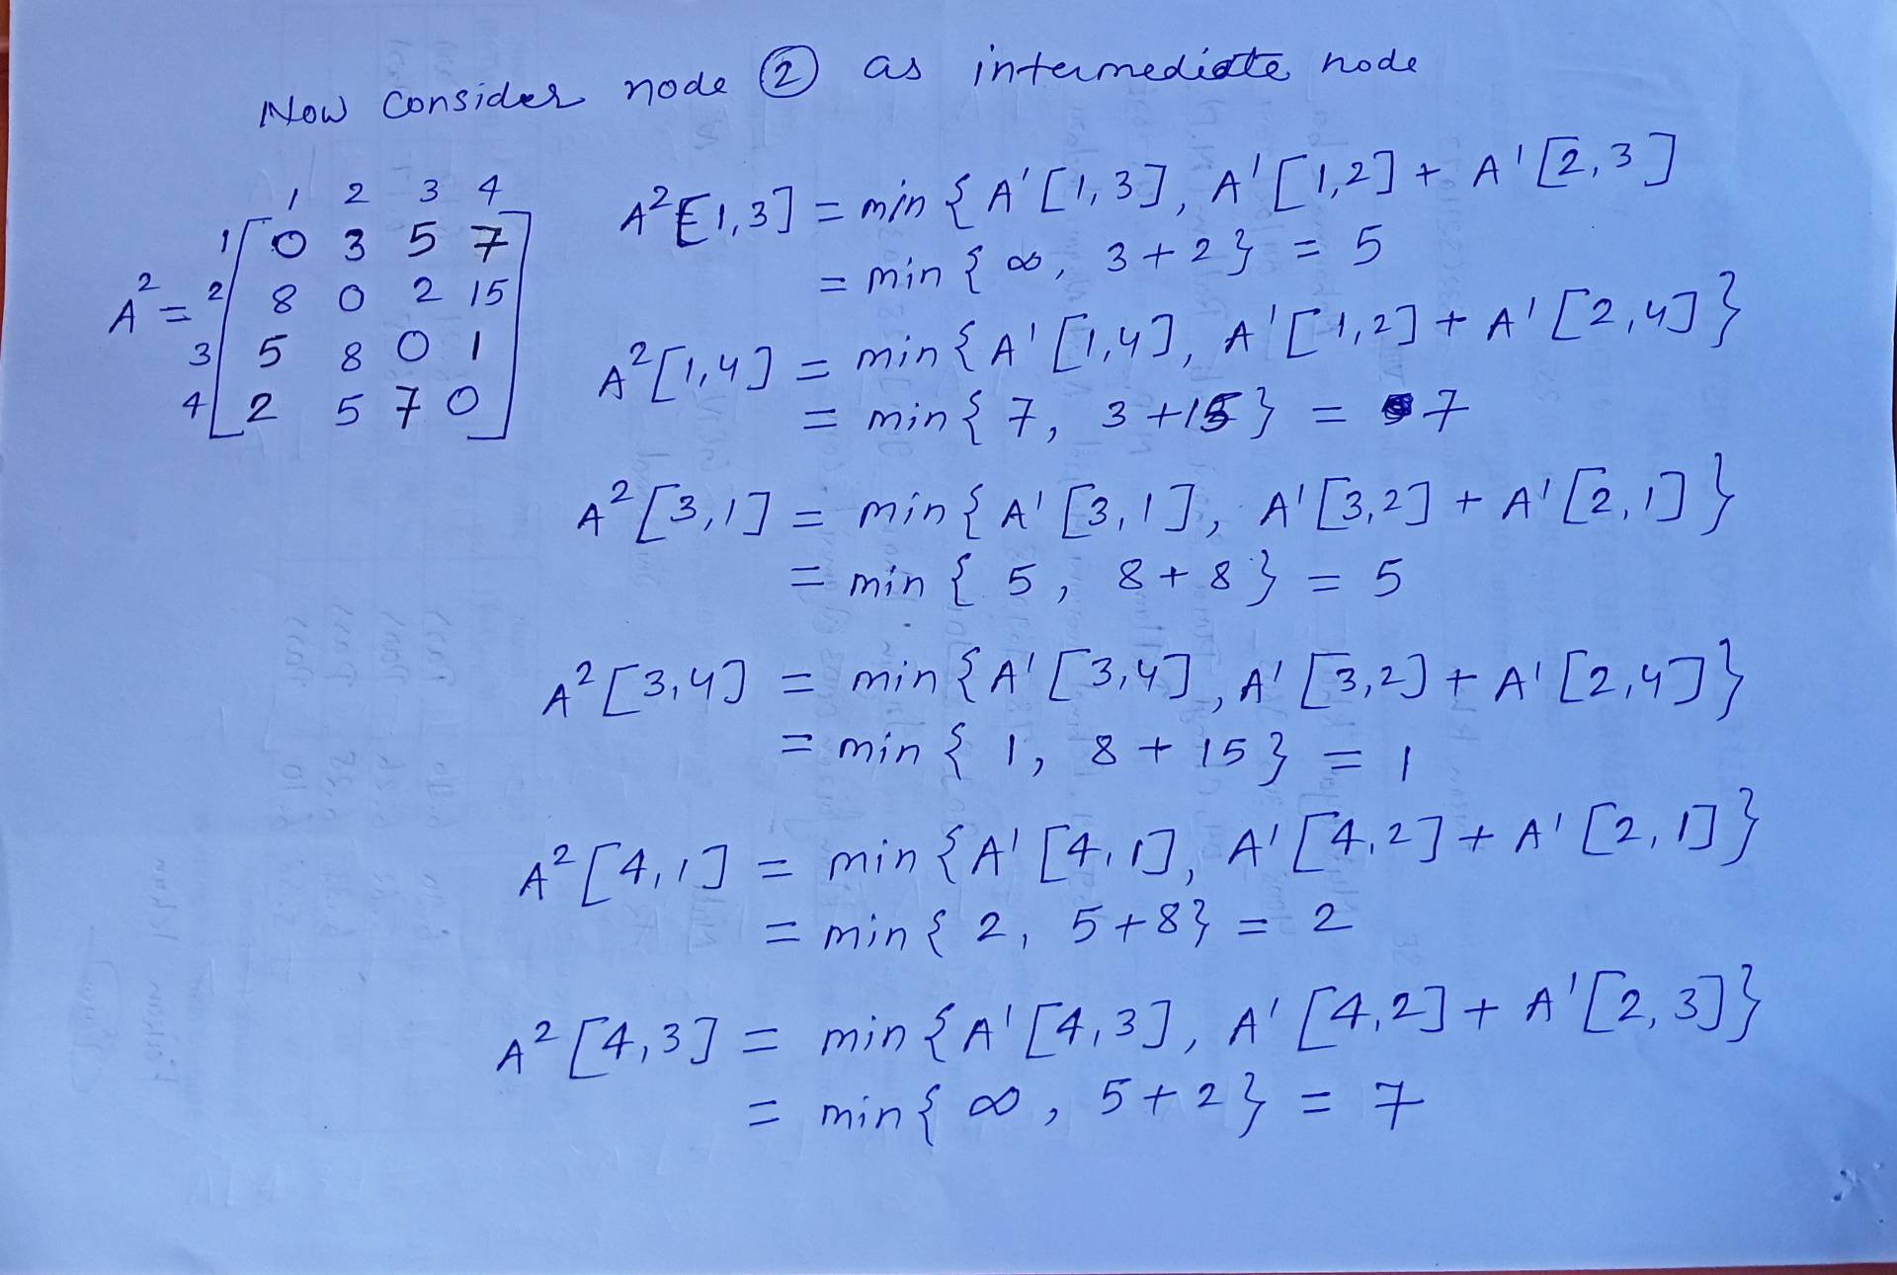
All Pairs Shortest Path (Floyd-Warshall algorithm)

Slide 32
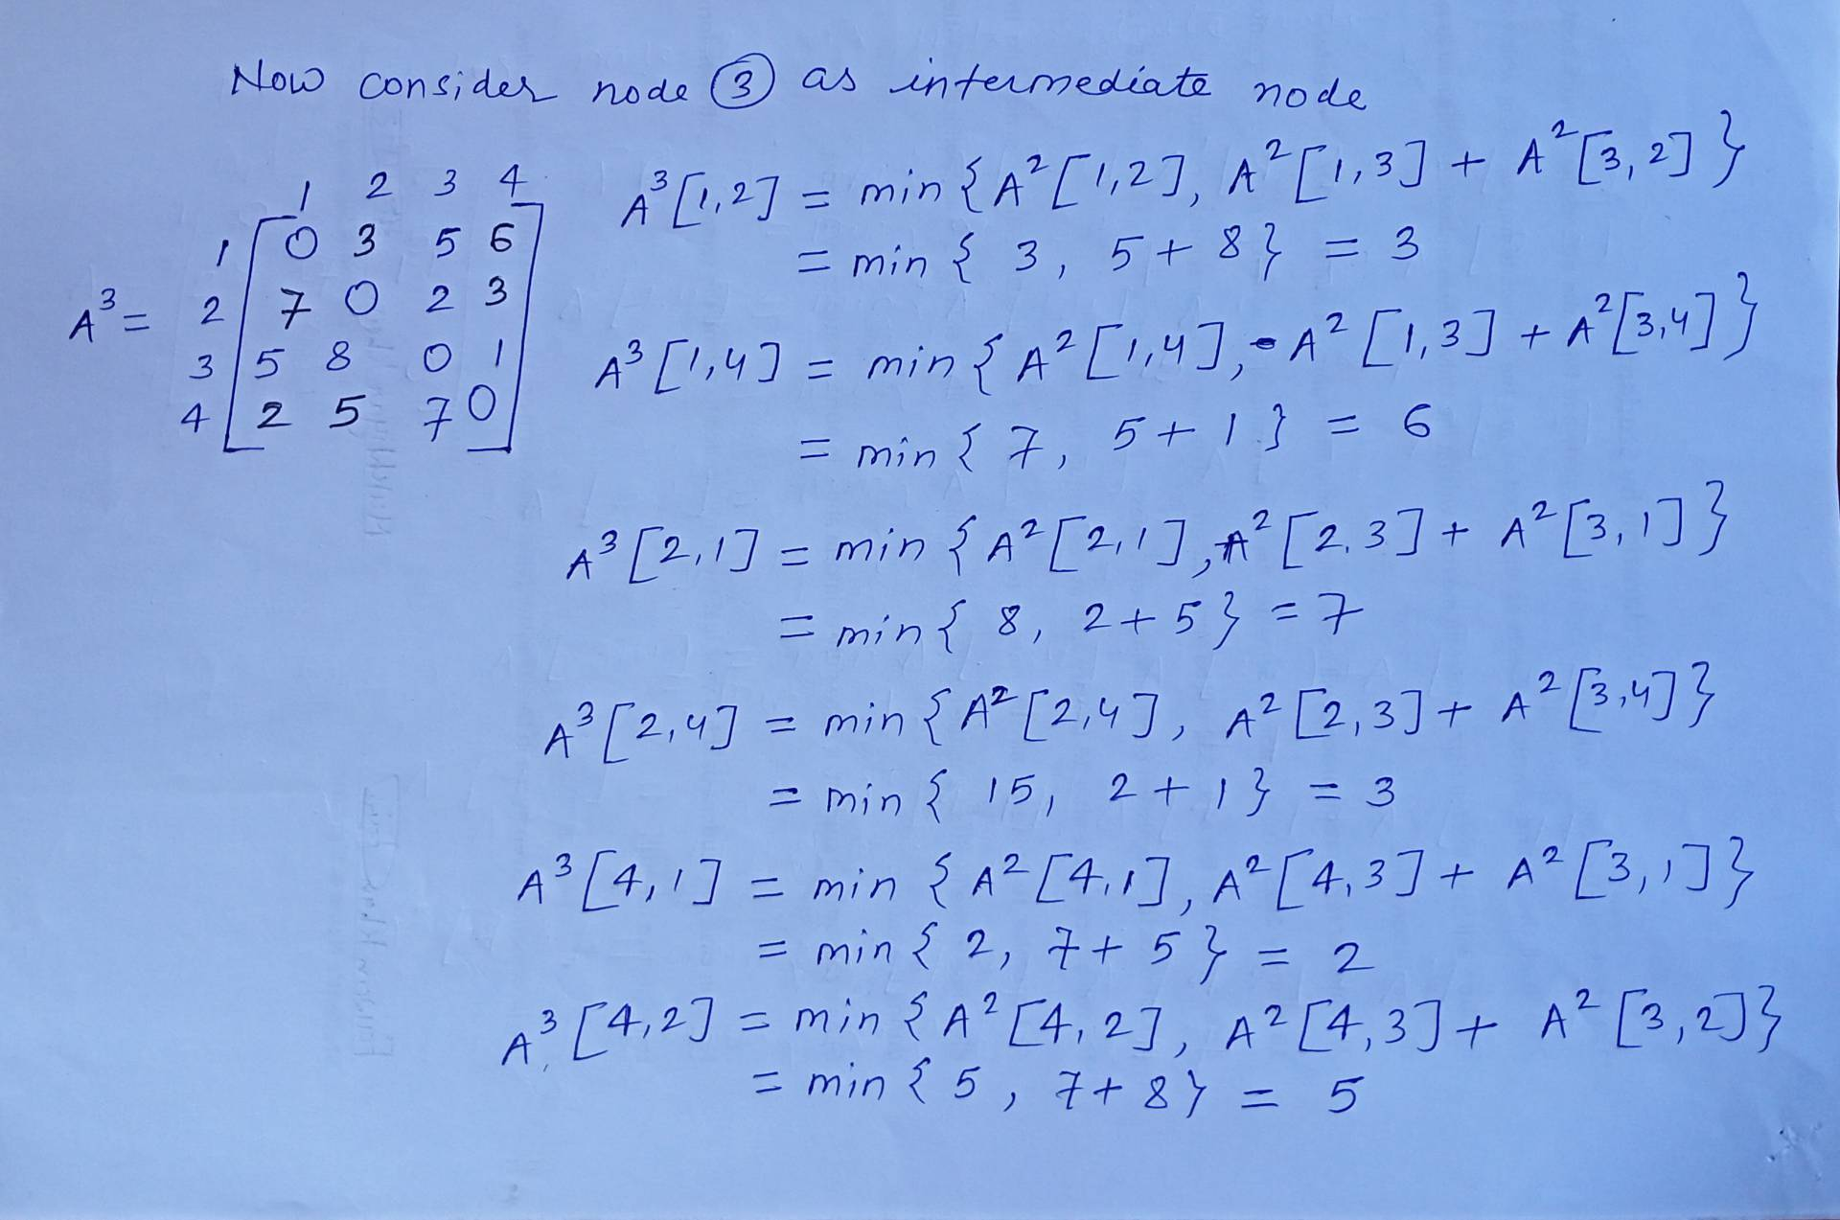
All Pairs Shortest Path (Floyd-Warshall algorithm)

Slide 33
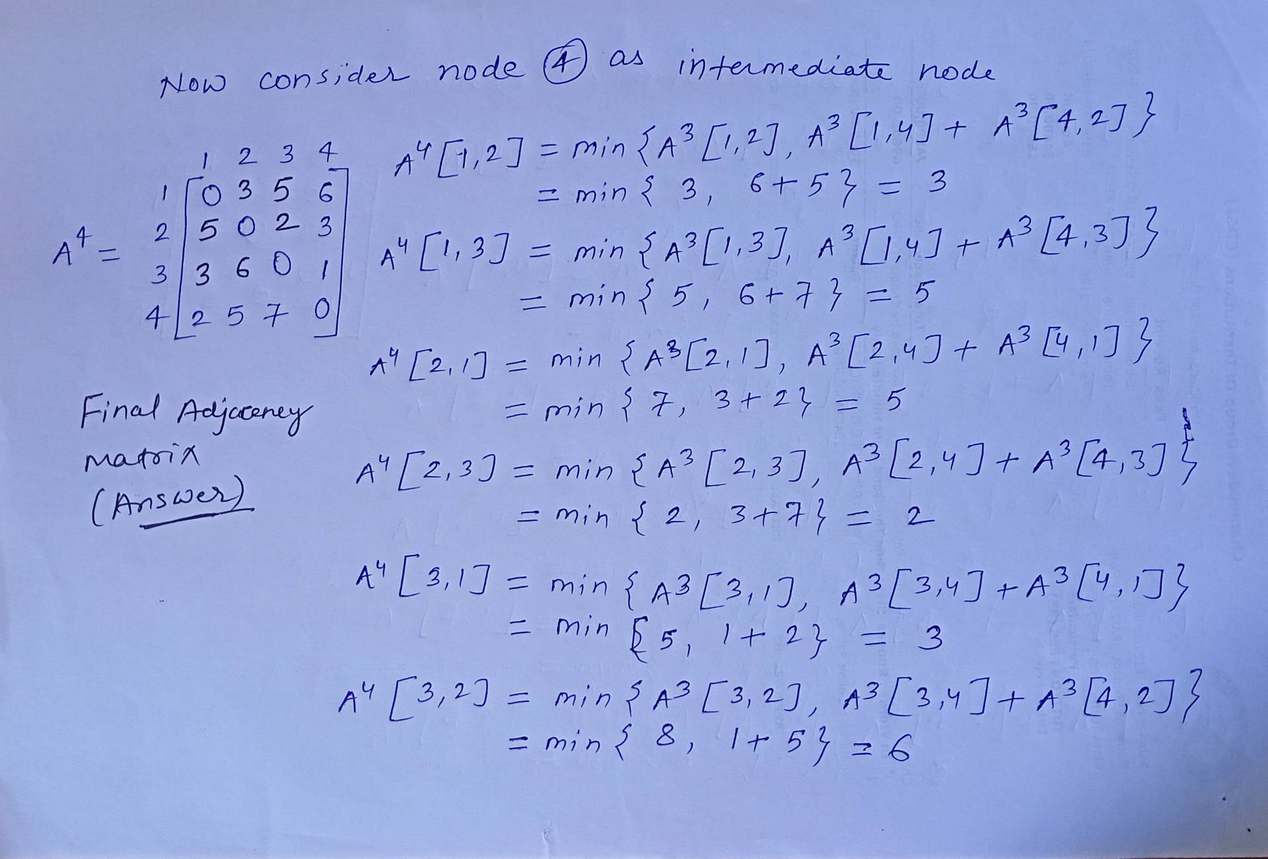
All Pairs Shortest Path (Floyd-Warshall algorithm)

Slide 34
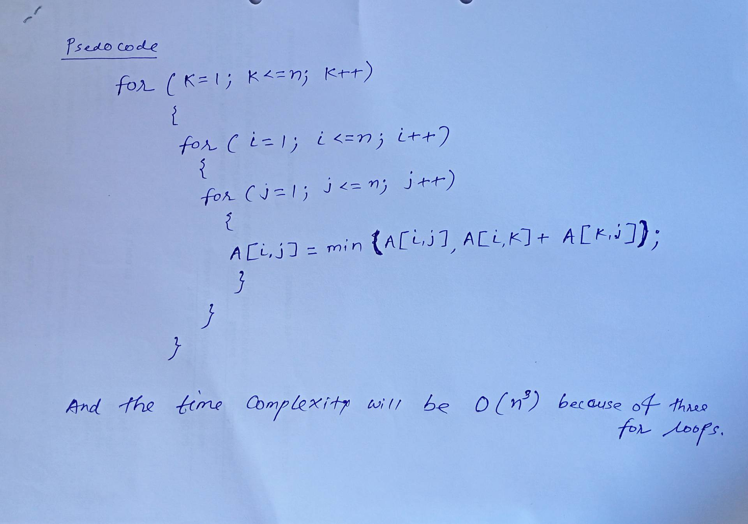
All Pairs Shortest Path (Floyd-Warshall algorithm)

Slide 35
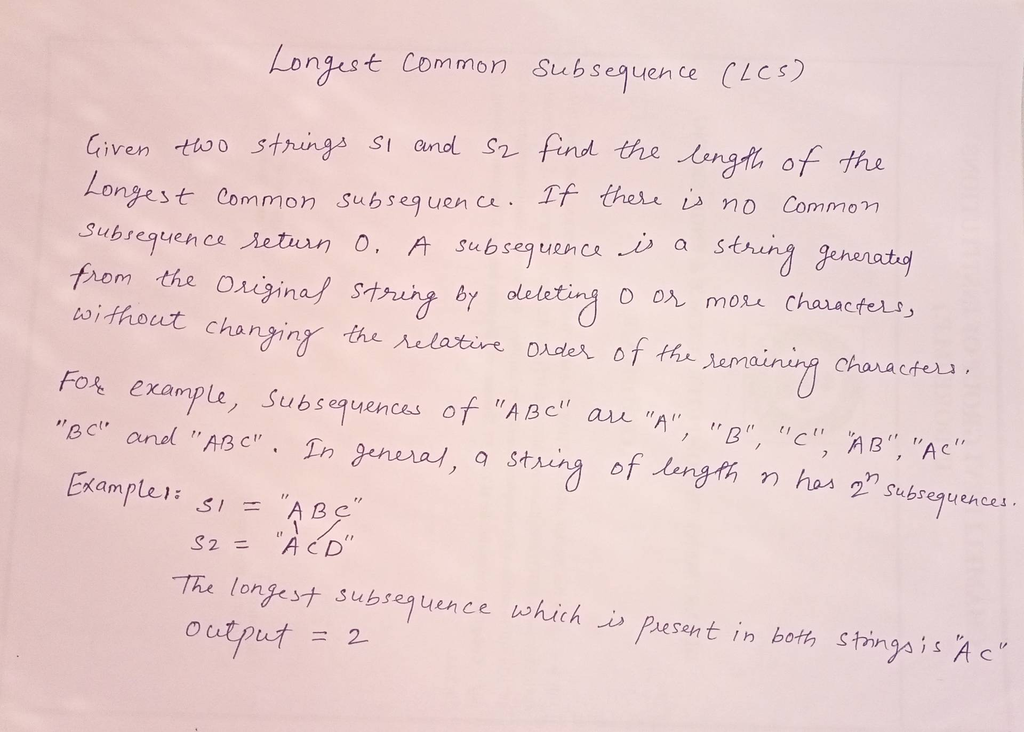
Longest Common Subsequence

Slide 36
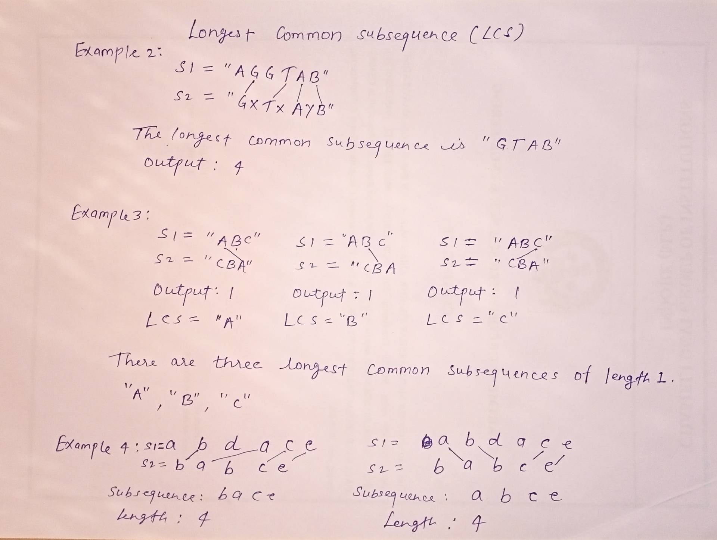
Longest Common Subsequence

Slide 37
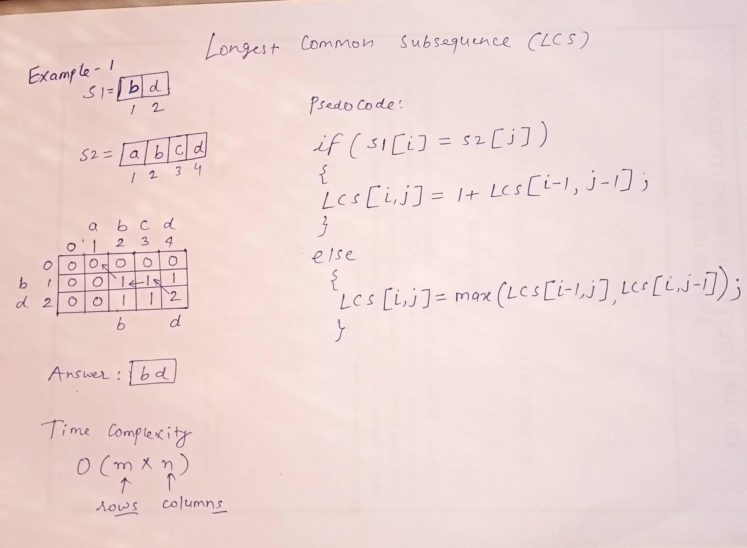
Longest Common Subsequence

Slide 38
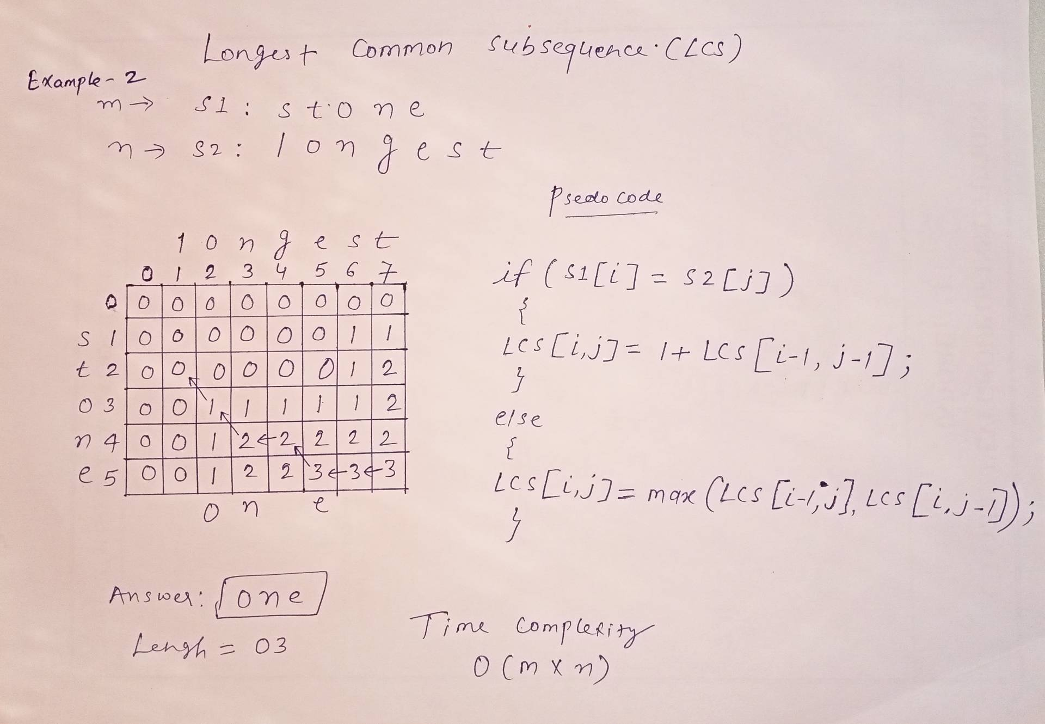
Longest Common Subsequence

Slide 39
Thank You

